Slide 1


Slide 2
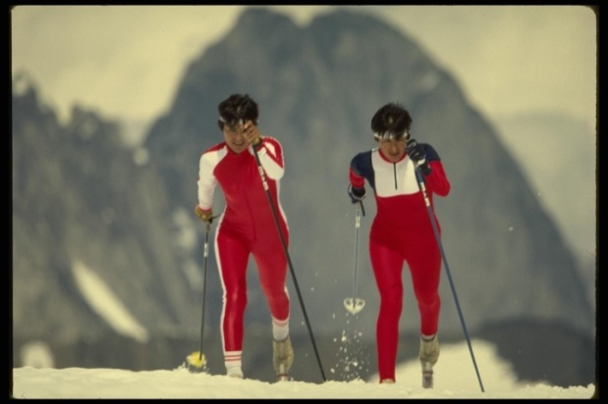
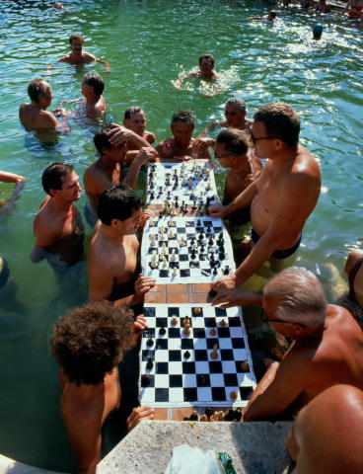



Many people have hobbies. Hobby is what you can and like to do, when you have free time. We choose a hobby according to our personality and tastes. When we have a hobby our life becomes more interesting. Hobby can be a good way to deal with stress. It often helps to develop the mind, to get on with friends and helps us to choose our future profession.

Slide 3
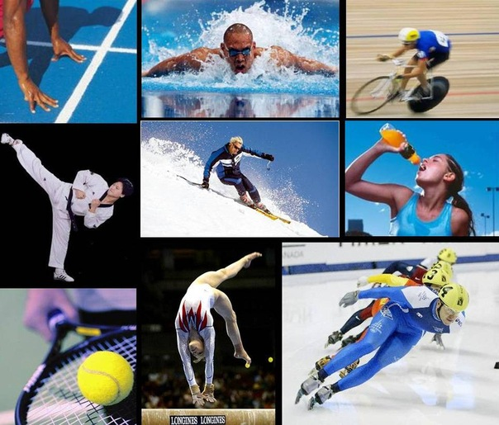
S p o r t
Many people go in for sports. Sport is very important in our life. It is popular among young and old people. Many people do morning exercises, jog in the morning and train in clubs in different sections and take part in sport competitions.

Slide 4
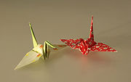


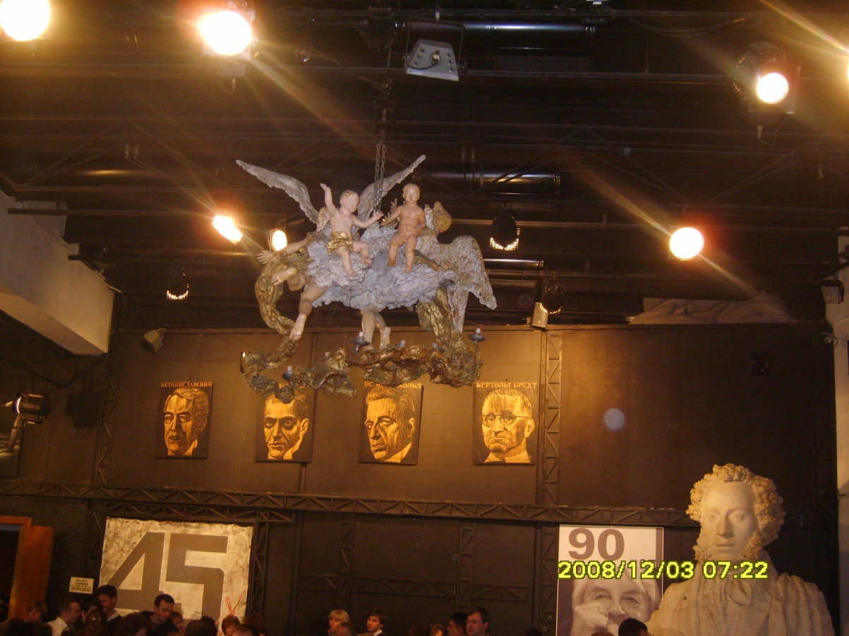

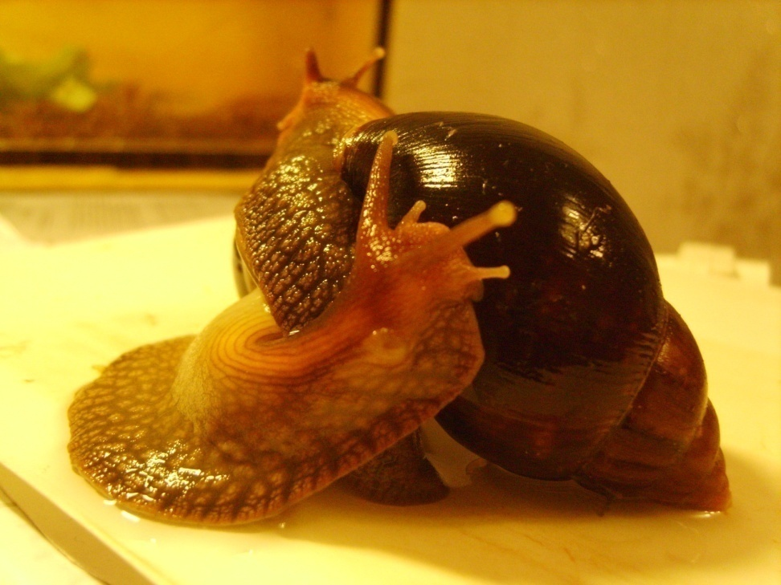
Some people are fond of music, others like to read books. Some people like to collect stamps, coins or badges, others prefer gardening or hiking or taking photographs. Some people like to cook, others like to knitter sew. Generally speaking, a hobby is a matter of taste.

Slide 5
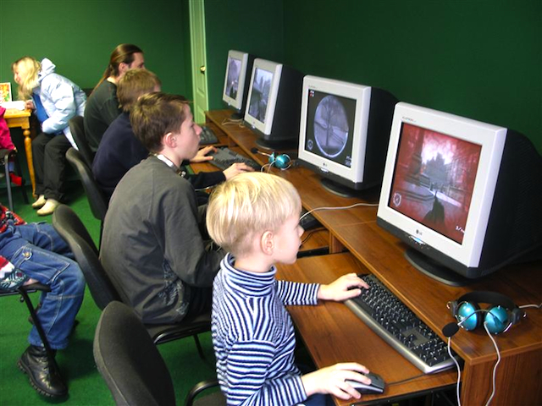

Most of my friends’ hobby is a computer, playing computer games. Both grown-ups and children are fond of it now. It has become one of the most popular hobbies nowadays. I think that playing with a computer is very interesting. It is not only "wasting time" as some people say. And it’s very interesting to know more new information about different technology.

Slide 6

Fishing is one of the most popular hobbies, it’s sport and just pleasure.

Slide 7
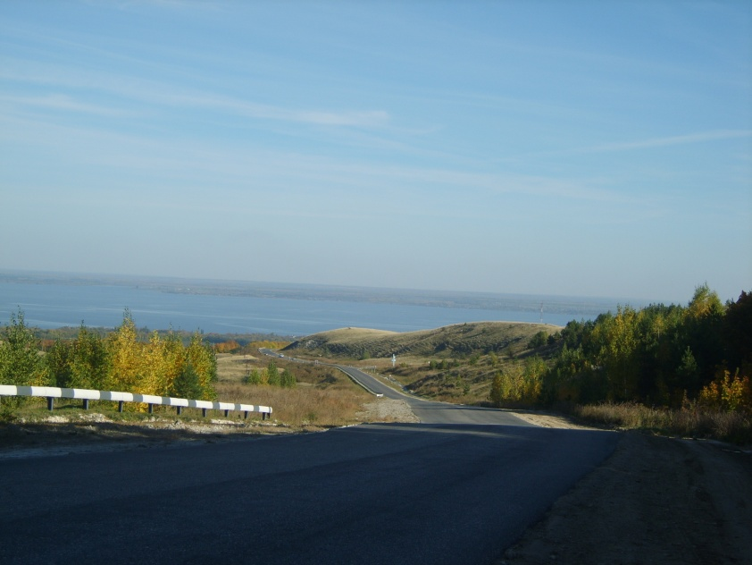
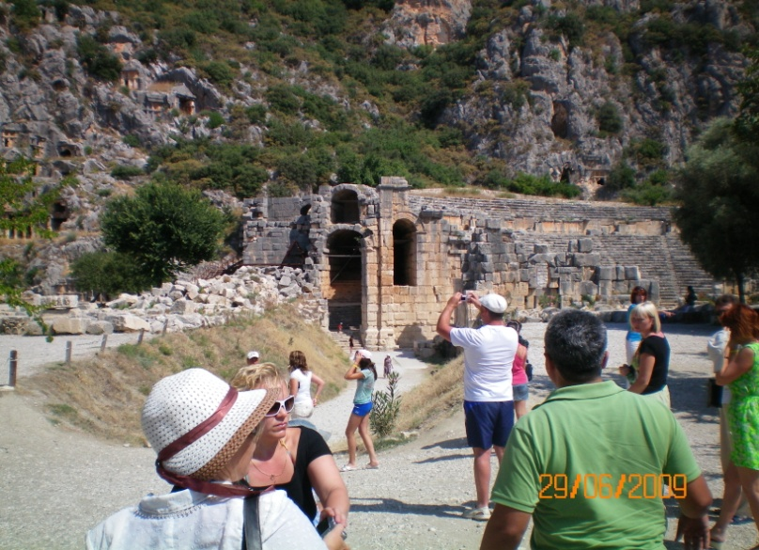
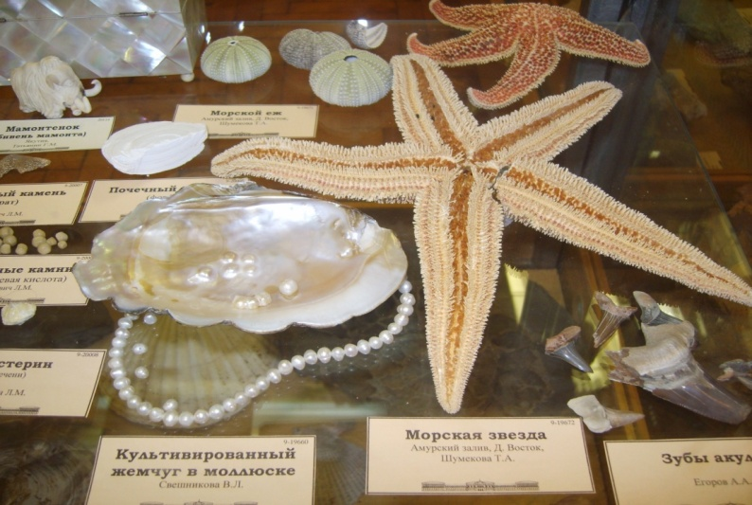
Travelling
Some people like going to the country, others prefer sitting at home and watching TV all day long. But more and more people travel. There are many reasons for traveling. Some people travel on business, others travel to visit their families, but most people travel to see the world and different countries. As for me I like to travel very much. Some people like to do it by car, others prefer to travel by ship or by plane. After my first flight with my parents I liked airplanes

Slide 8
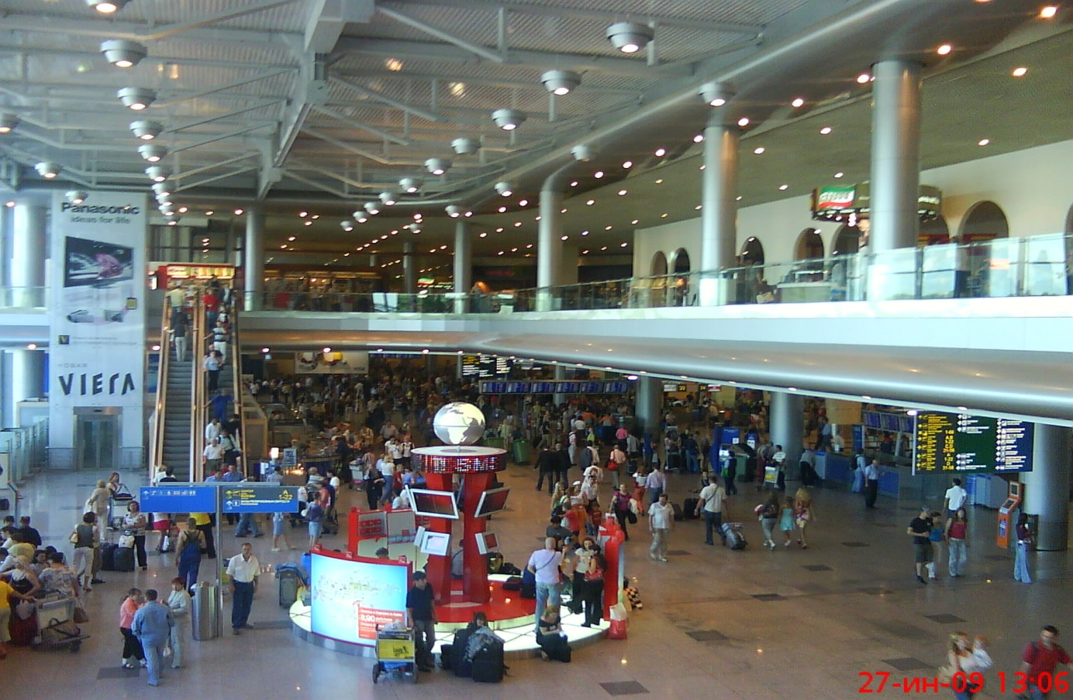
Today less than half of all international trips made on land roads, and the role of air transport increases annually. In 1992 only 5% of travelers use the rail system for international transfers (mainly in Europe) and 8% traveled by boat and ferries (for example, between Britain and France, Italy and Greece, Sweden and Denmark), and 40% of visitors traveled to destination planes.

Slide 11

Thank you for your attention!

