Slide 1
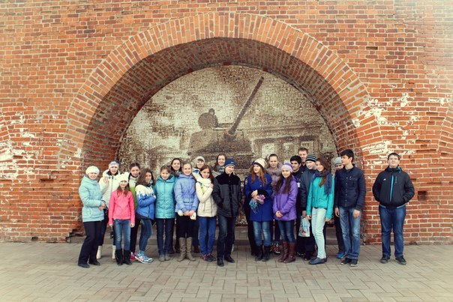
My CLASS BOOK

Slide 2

Content
1 what distinguishes our class from the other?
2 Our hobbies
3 Plans for the future
Our Class

Slide 3
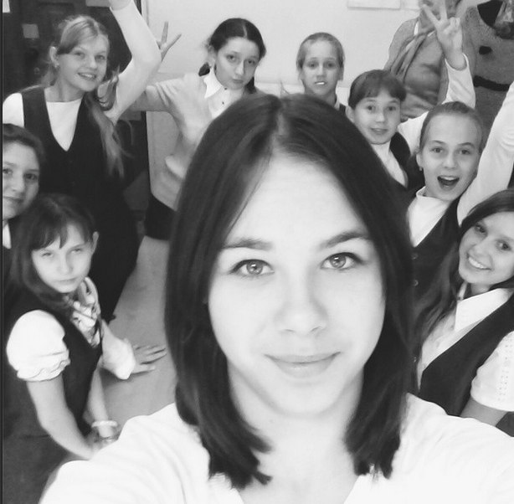
what distinguishes our class from the other?
Our class is much different from other. He is very friendly, bright, and we have a lot of abilities, and each has its own chief. together we love to make different excursions to interesting places, to arrange surprises, and to prepare the holidays.

Slide 4
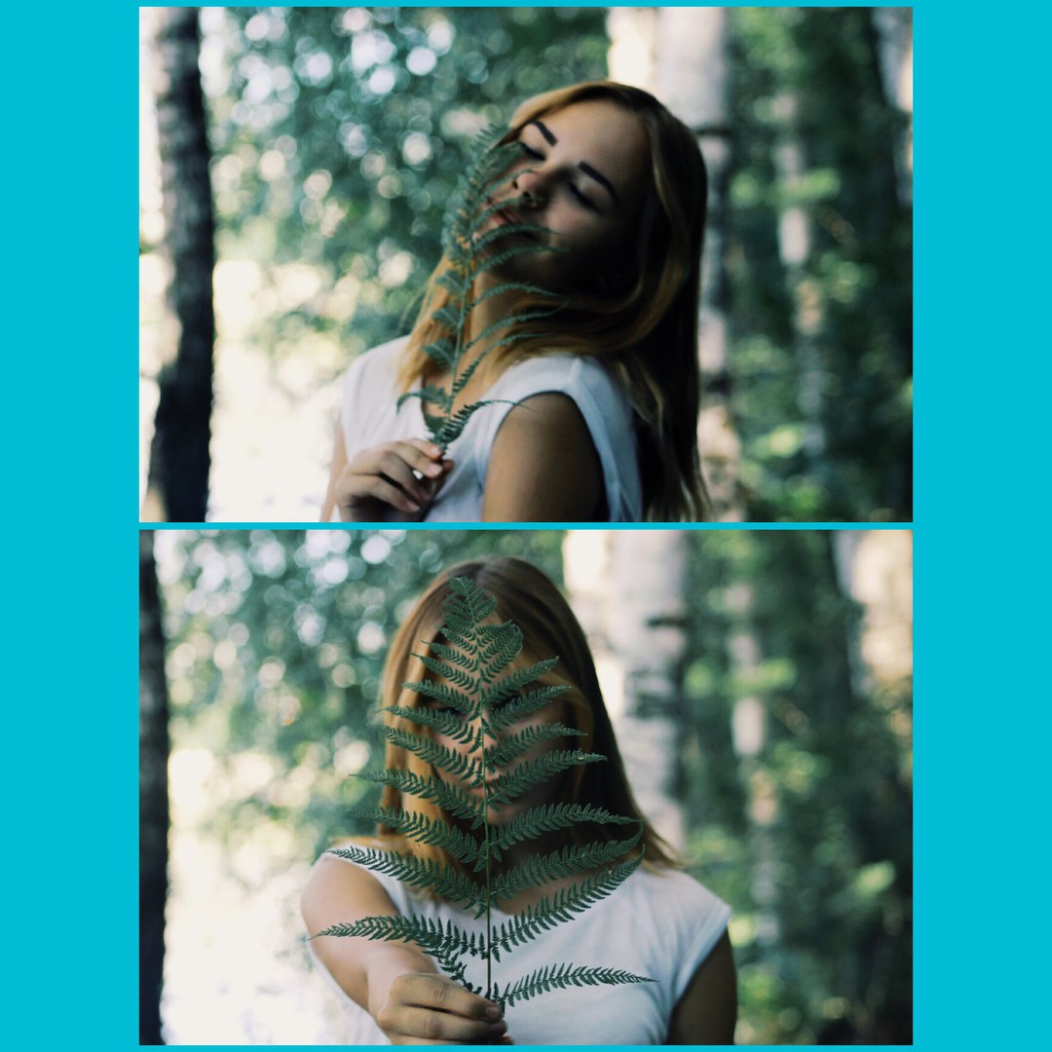
Our hobbies and Plans for the future
Bukarёva Julia
Julia plays sports, athletics. SHE has many medals and diplomas. She wants to leave after grade 9th, in teaching a teacher of Russian language and literature.

Slide 5
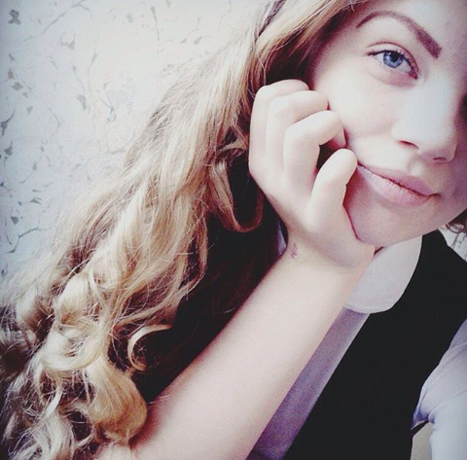
Our hobbies and Plans for the future
Natalia Malysheva
Natasha really like sports, she is very active, she likes to take part in all sorts of activities in and out of school. She wants to leave after grade 9th and enter a medical

Slide 6
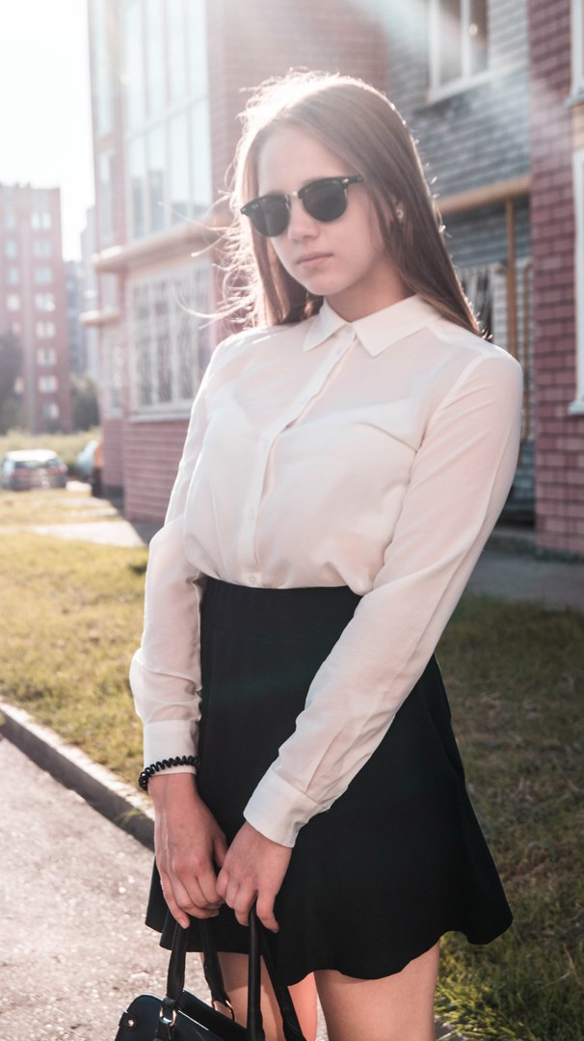
Our hobbies and Plans for the future
Marina Smyslova
Marina is one of the best students in our class. She communication a sports. But that's not all! As the Marina is very cool drawing! She was seven years engaged in gymnastics She will learn to grade 11th. And it is going to go to medical…

Slide 7
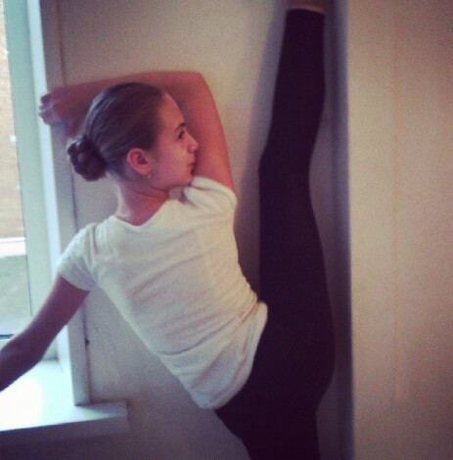
Our hobbies and Plans for the future
Polina Tarasova
One of the best students in our class. Polina loves history and social studies. she was seven years engaged in gymnastics. she wants to finish the 11th grade with good marks.

Slide 8
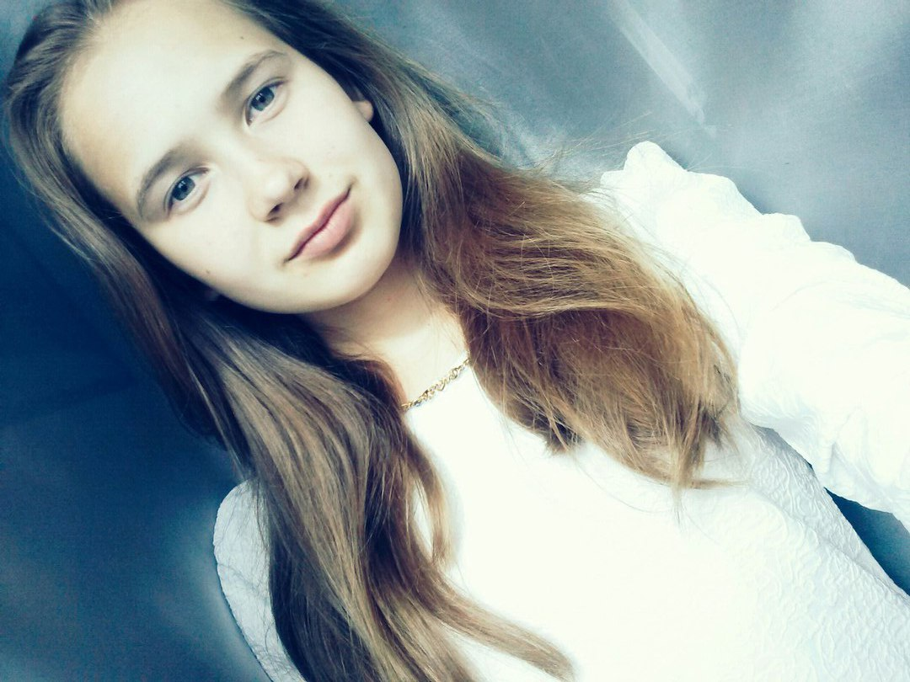
Our hobbies and Plans for the future
Ovchinnikovа Alina
Alina recently graduated from music school, she plays the piano and has a beautiful voice. She like geography lesson. She will arrive in grade 11th

Slide 9
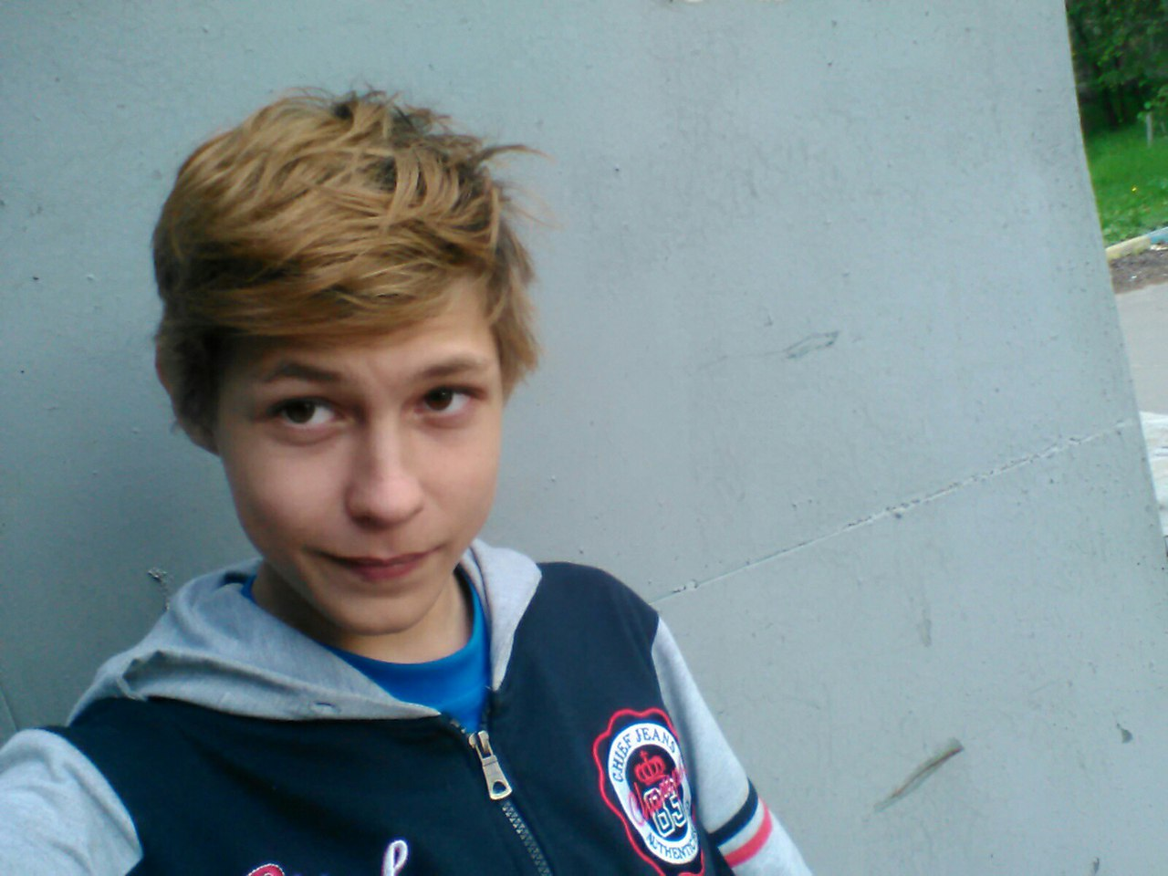
Our hobbies and Plans for the future
Tyulenev Alexsey
Lёsha finished music school, plays the piano, the flute, and sings beautifully. And also deals with light athletics, playing football. He is going to leave the field 9th tension cook.

Slide 10
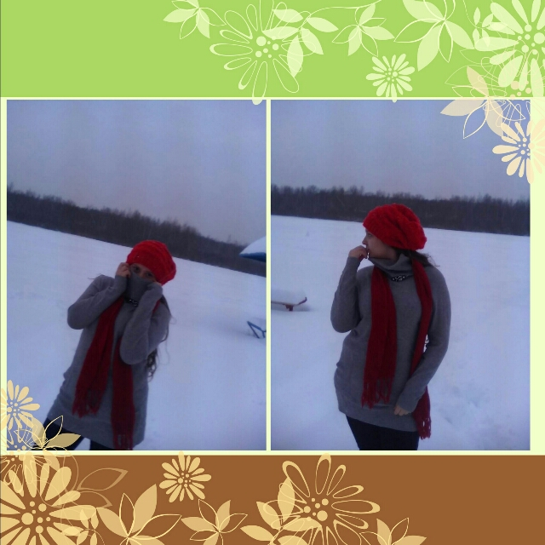
Our hobbies and Plans for the future
Ragimova Arzum
She studied at the School of Music, she plays the piano and sings. she likes to read foreign literature. She is going to leave after grade 9th and enter a medical.

Slide 11
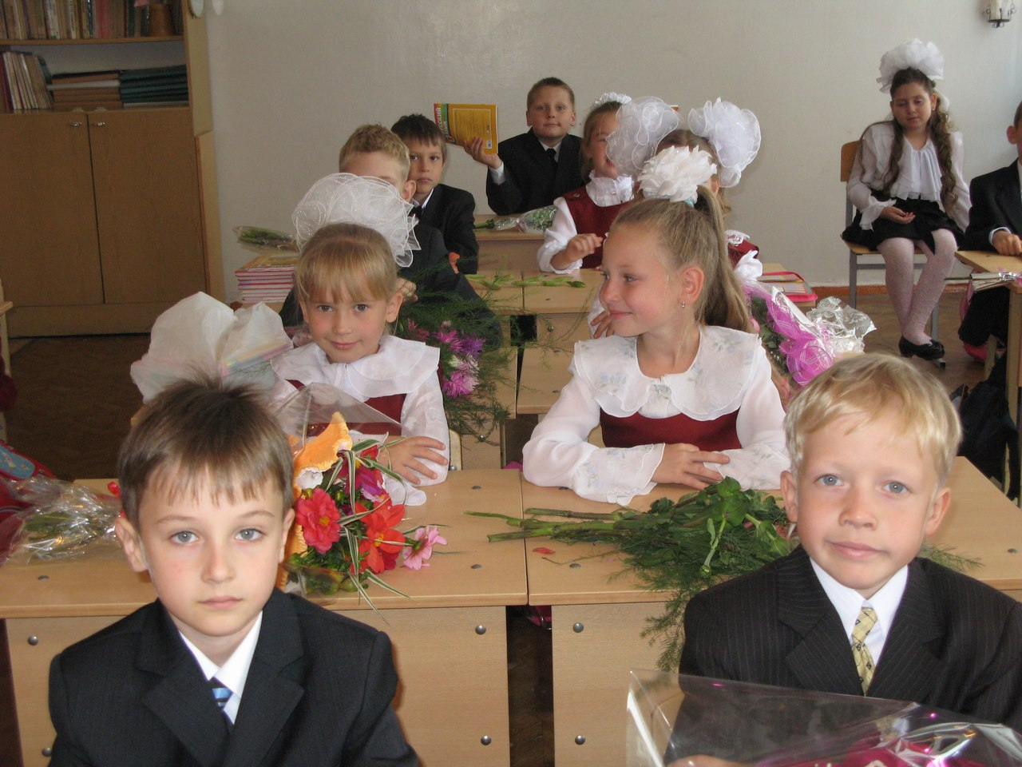
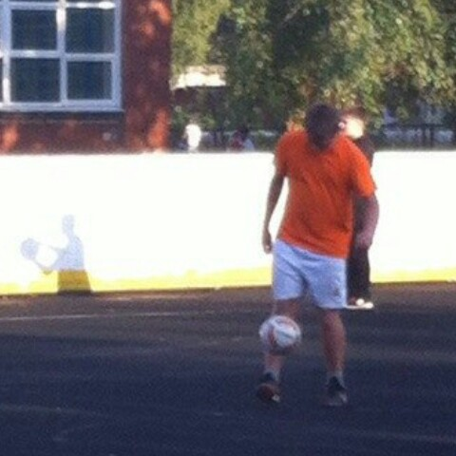
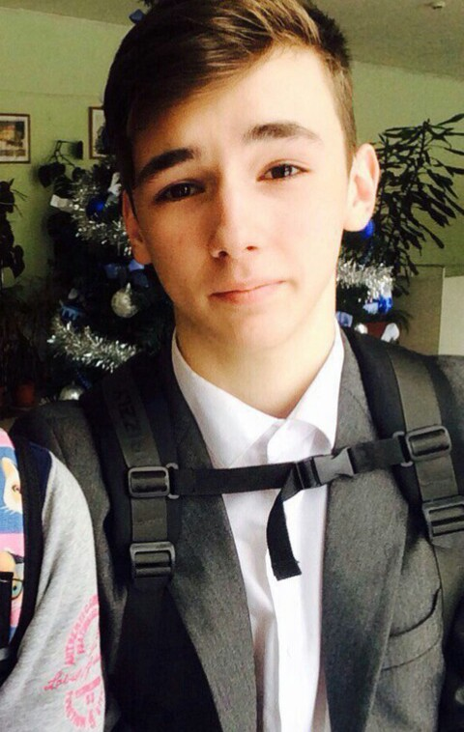

Cheknyaev Danil.
He plays sports, playing football and hockey. Really like physical education. Going to leave after grade 9th.
Our hobbies and Plans for the future
Radosavleevich Alexander.
Very fond of computer science lessons. He likes to play computer games. if he has not yet decided to leave after 9th going to act on the programmer.
Schukin Artem.
Very fond of the lessons of physical education,
is about to leave after grade 9th.

Slide 12
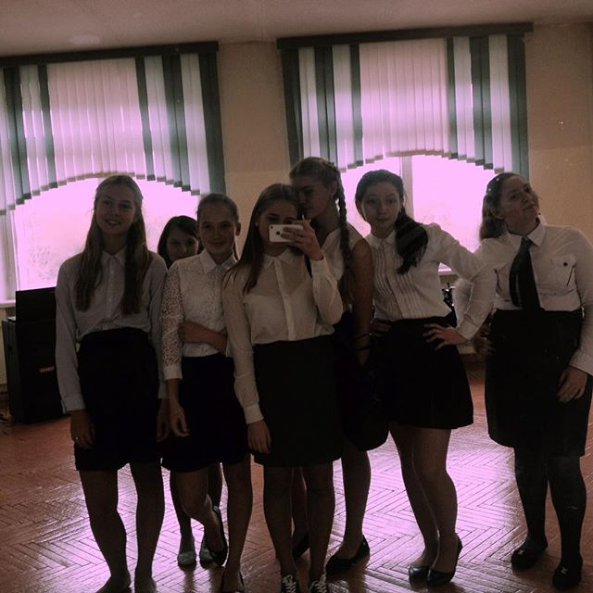
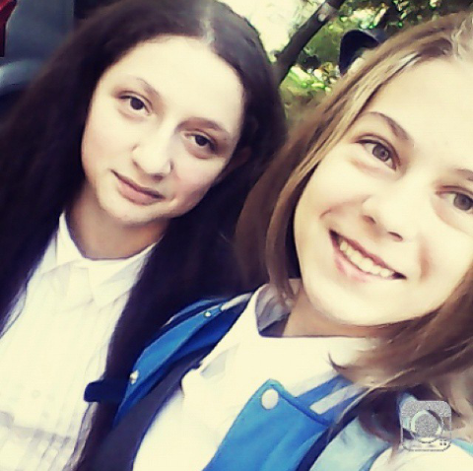
Our hobbies and Plans for the future
Mirzoyan Ani
she is one of the best students in our class, she loves the lessons of history and art, very beautiful painting. Ani wants to go to 11th grade.

Slide 13
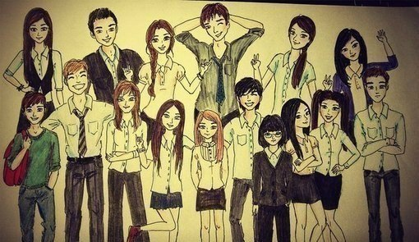
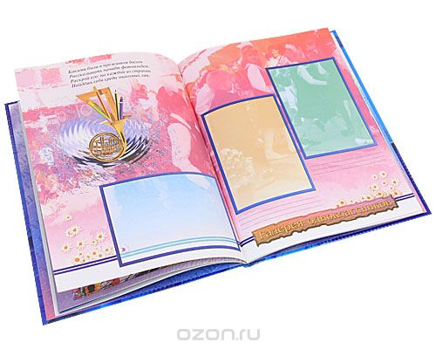
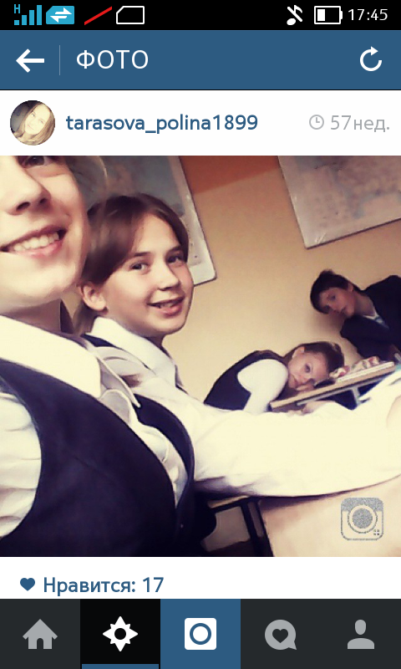
Our Class
It is not our whole class .... This is just a group of English)
Sasha Botin, Gladkov Mark, Malyshev Andrey, Malisheva Ksenia, Vatarmina Nastya, Lapatkina Tanya, Zhabrov Vlad, Zakharov Danil, Klimov Vova, Kuzovenkov Nikita, Chesnokov Roman.

Slide 14
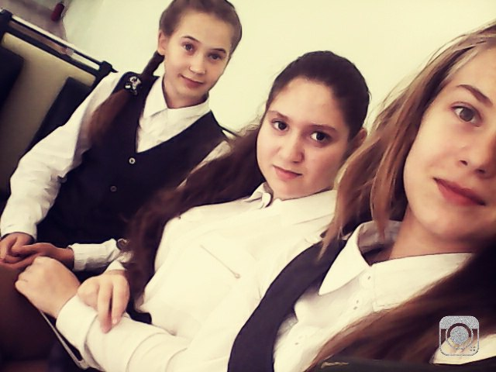
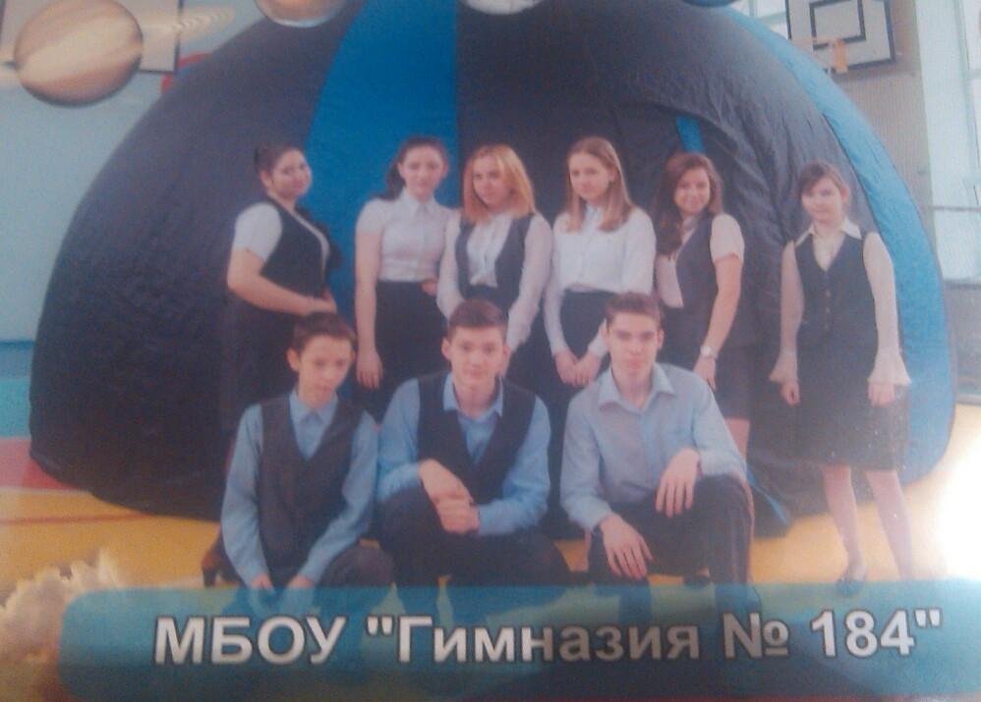
THE END
9 v

