Slide 1
Computer
Тут твое имя

Slide 2
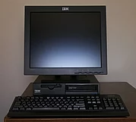
Computer
A computer is a machine that can be instructed to carry out sequences of arithmetic or logical operations automatically via computer programming.

Slide 3
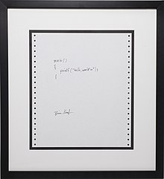
Computer program
A computer program is a collection of instructions that can be executed by a computer to perform a specific task.

Slide 4
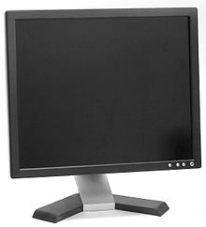
Computer monitor
A computer monitor is an output device that displays information in pictorial form. A monitor usually comprises the visual display, circuitry, casing, and power supply.

Slide 5

Computer keyboard
A computer keyboard is a typewriter-style device which uses an arrangement of buttons or keys to act as mechanical levers or electronic switches.

Slide 6
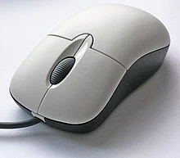
Computer mouse
A computer mouse is a hand-held pointing device that detects two-dimensional motion relative to a surface.

Slide 7

Thanks for attention

