Slide 1
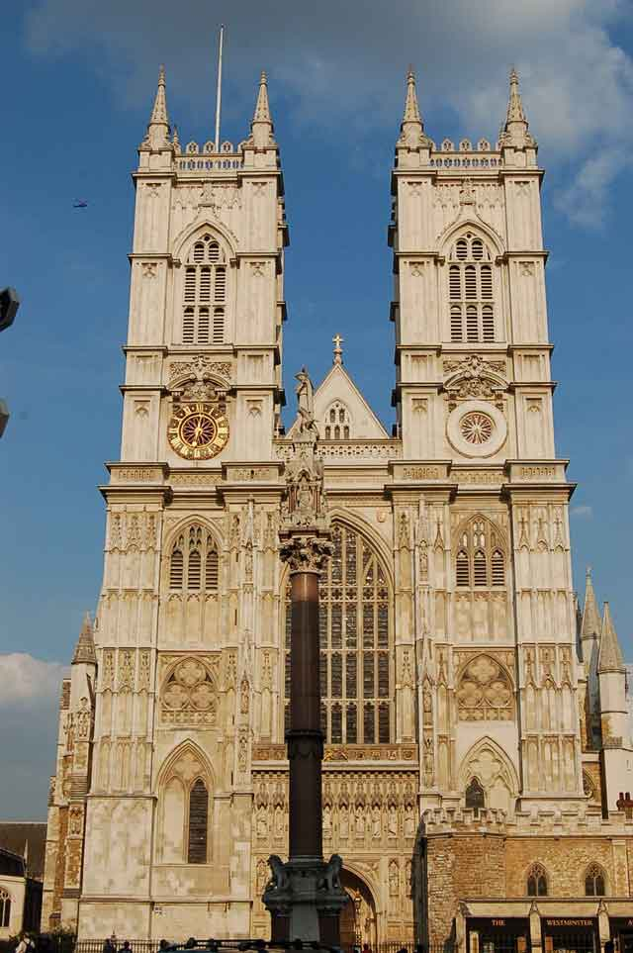
Westminster Abbey
Westminster Abbey is a
Gothic church in London that is the
traditional place of coronation and
burial for English monarchs. Located next to the Houses
of Parliament in the heart of
London.

Slide 2
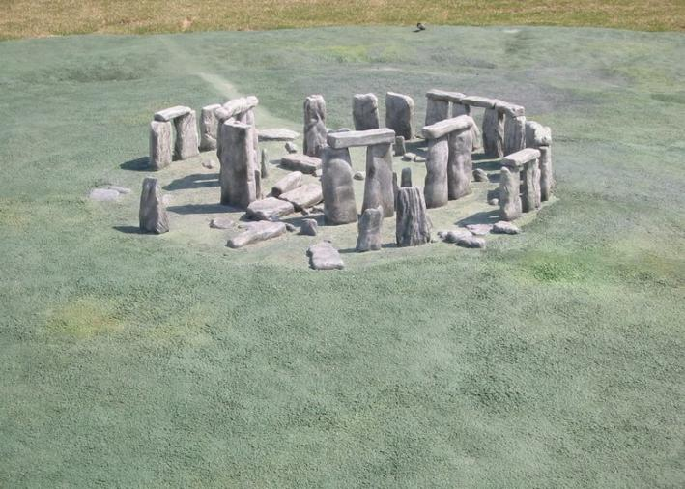
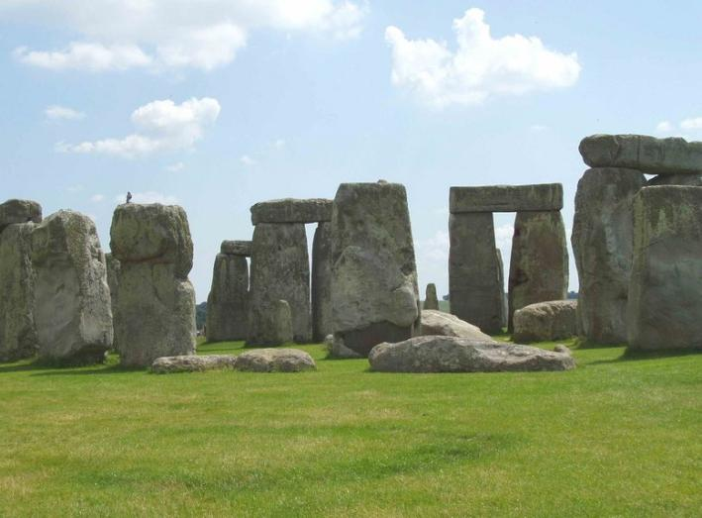
Stonehenge
Stonehenge is a prehistoriс
monument located in the
English county ofWiltshire,about
13 kilometres north of
Salisbury. One
of the most famous sites in
the world, Stonehenge is
composed of earthworks
surrounding a circular
setting of large standing
stones.

Slide 3
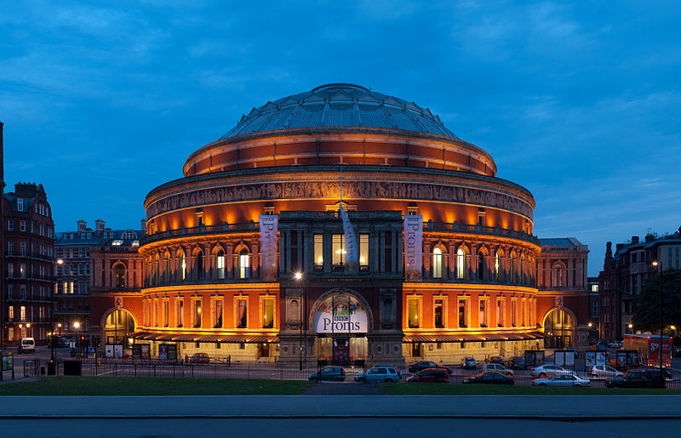
The Royal Albert Hall
The Royal Albert Hall is a concert hall situated in London.
The Royal Albert Hall is one of the UK's most treasured and distinctive buildings, recognizable all over the world. Since its opening by Queen Victoria in 1871, the world's leading artists from every kind of performance genre have appeared on its stage. Each year it hosts more than 350 performances including classical concerts, rock and pop, ballet and opera, award ceremonies, school and community events, charity performances .

