Slide 1
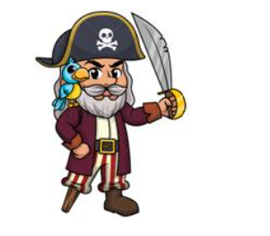
Task 1. Read the text and choose True / False.
Задание 1. Прочитайте и укажите Правда / Ложь
The old pirate
This is the old pirate. His name is James. He has got grey hair and beard.
He is very kind. He has got many coins and gold in his treasure chest.
James sails on his ship and gets pearl and treasures. He also has got a blue parrot.
The parrot’s name is Lucky. They help poor people.
They give them gold and treasure. People call them heroes of sea.
The pirate’s name is Jack. True/False.
The pirate has got a bird. True/False.
How do people call the pirate and the bird?
a. heroes of the sea
b. Lucky and James
c. superheroes
[3] points

Slide 2
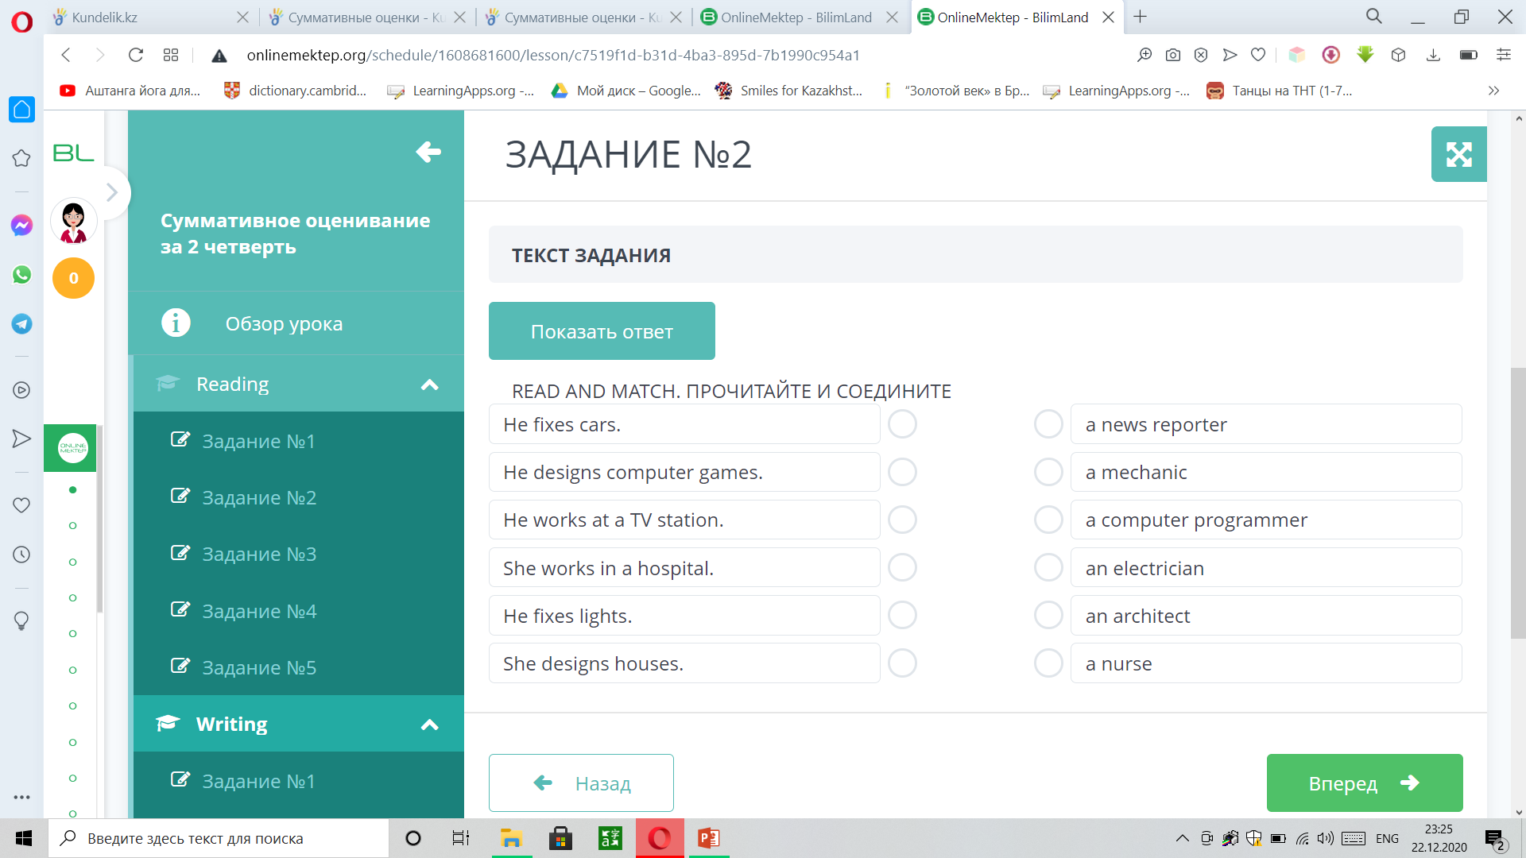
Task 2. Read and match.
Задание 2. Прочитайте и соедините.
1.
2.
3.
4.
5.
6.
a.
b.
c.
d.
e.
f.
[3] points

Slide 3
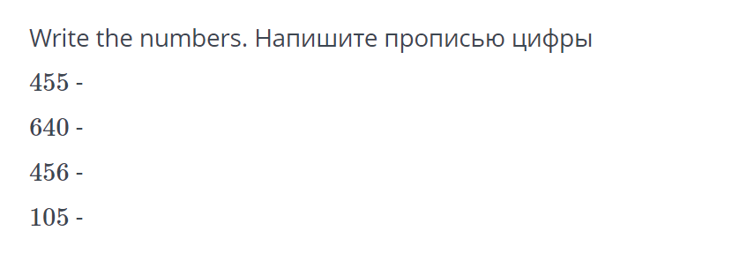
Task 3.
Задание 3.
[3] points

Slide 4
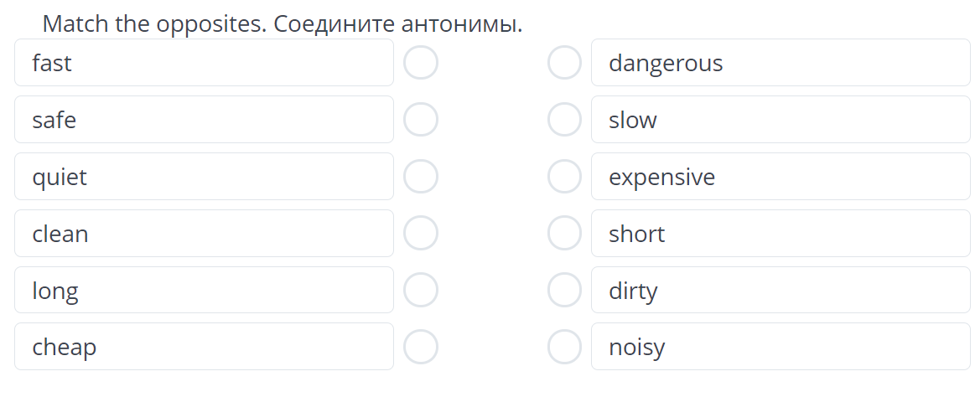
Task 4. Read and match.
Задание 4. Прочитайте и соедините.
1.
2.
3.
4.
5.
6.
a.
b.
c.
d.
e.
f.
[3] points

