Slide 1
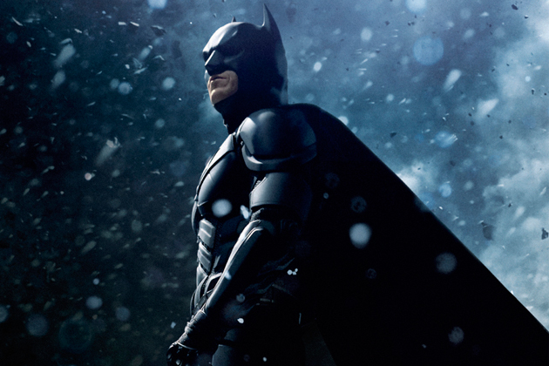
My superhero batman
By Alex Sh.

Slide 2
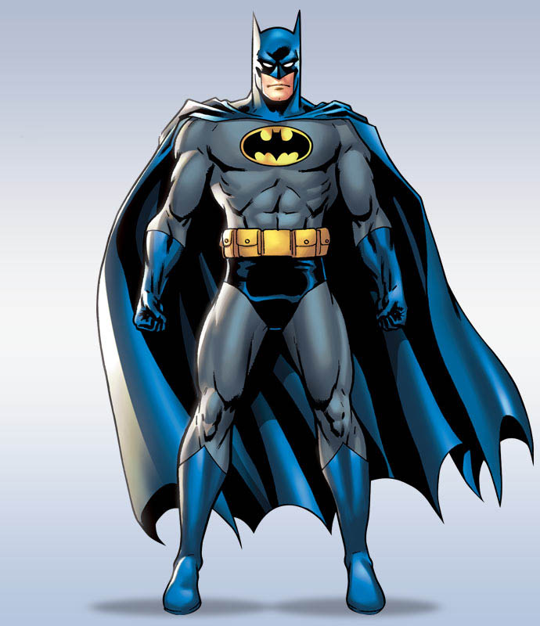
My Superhero
Batman
Batman is a famous superhero. His real name is Bruce Wayne and he is very rich.
Batman is very strong and clever. He helps good people in his city. His cloak helps him to fly!

Slide 3
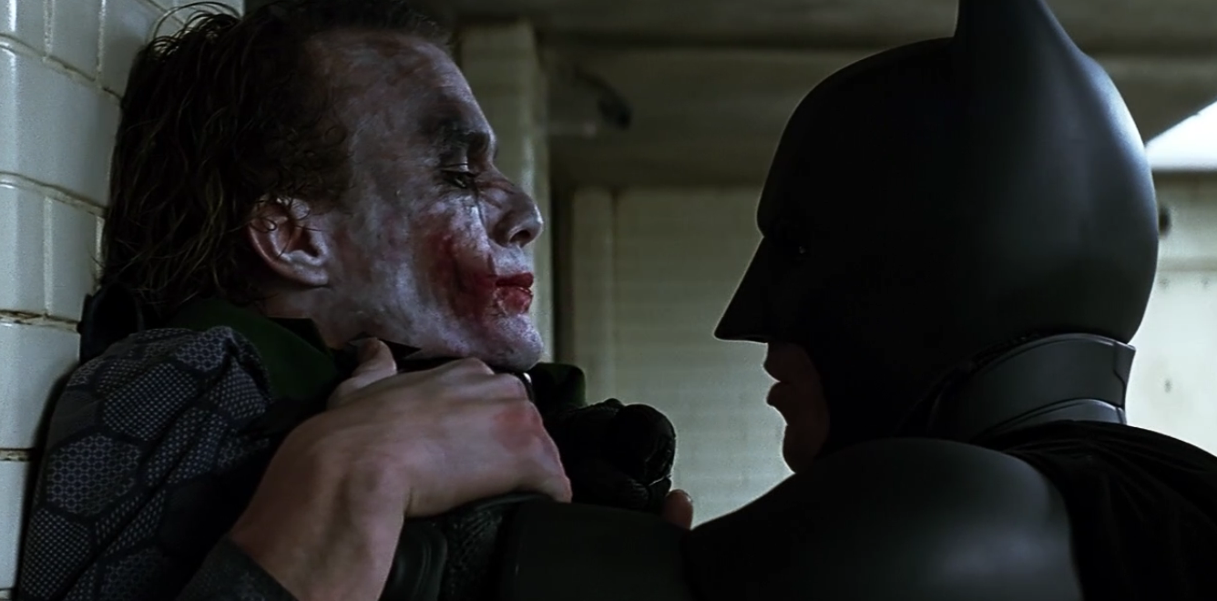
My Superhero
Batman
In this picture Batman is wearing his black costume and his bat mask. He’s fighting Joker, because Joker hates good people

