Slide 1
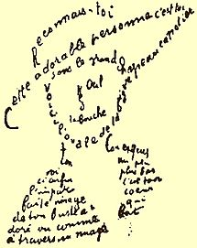
Alexander Block
(Poet)

Slide 2
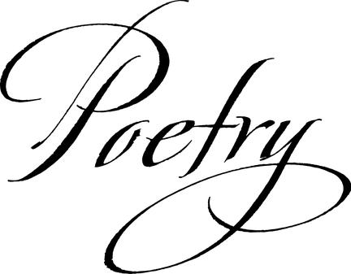
He was born in Saint Petersburg on 16 November 1880.
Block was a Russian lyrical poet.
He grew up into a sophisticated and intellectual family.
Philosopher Vladimir Solovyov had influenced to his vision.

Slide 3
He married Lyubov Dmitrievna Mendeleeva, daughter of famous scientist in chemistry Dmitry Mendeleev, who created periodic table.
He wrote a lot of poetry for her such as Verses About the Beautiful Lady.
However, they divorced due to that Lyubov Dmitrievna felled in love to Andrei Beliy.

Slide 4
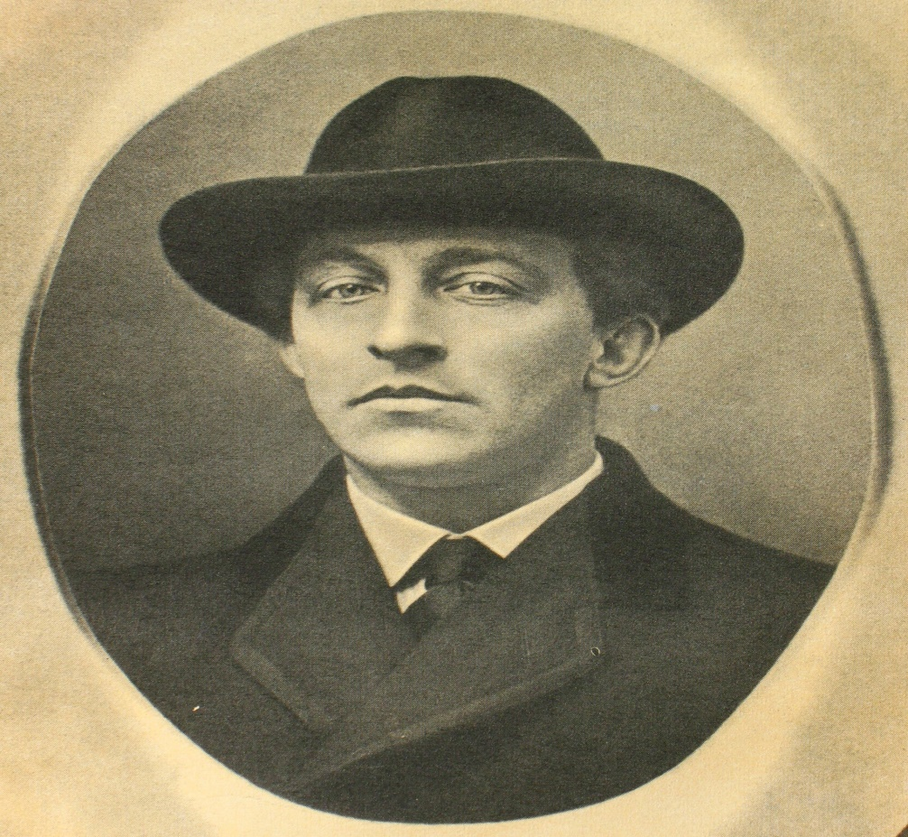

After divorce he wrote one of his famous poetry “"The night, the street, the lantern, the drugstore..." ”, that is topical nowadays too.

Slide 5
Some night and street, some chemist's lantern Is bringing senseless weary light. Well, nothing changes, that's one pattern, Live extra twenty-five and find. You die to start a life all over, All things repeat as did before. That night, cold waters at quay border, That light, that street, that chemist's store.
“
”
"The night, the street, the lantern, the drugstore..." (1912) Translated by Alexei Parphyonov

