Slide 1


Football

Slide 2
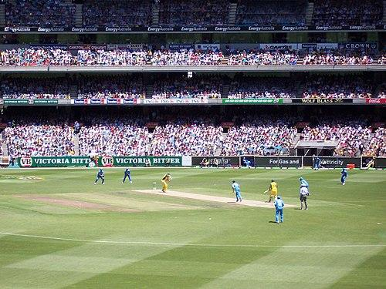
Football
Football is a family of team sports that involve, to varying degrees, kicking a ball to score a goal. Unqualified, the word football normally means the form of football that is the most popular where the word is used. Sports commonly called football include association football (known as soccer in North America and Australia); gridiron football (specifically American football or Canadian football); Australian rules football; rugby union and rugby league; and Gaelic football.
Team sport

Slide 3

Common elements
The various codes of football share certain common elements and can be grouped into two main classes of football: carrying codes like American football, Canadian football, Australian football, rugby union and rugby league, where the ball is moved about the field while being held in the hands or thrown, and kicking codes such as Association football and Gaelic football, where the ball is moved primarily with the feet, and where handling is strictly limited. Common rules among the sports include:Two teams of usually between 11 and 18 players;

Slide 4

Etymology
There are conflicting explanations of the origin of the word "football". It is widely assumed that the word "football" (or the phrase "foot ball") refers to the action of the foot kicking a ball. There is an alternative explanation, which is that football originally referred to a variety of games in medieval Europe, which were played on foot. There is no conclusive evidence for either explanation.

Slide 5
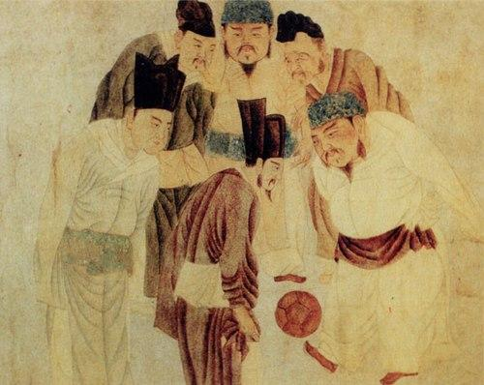
Ancient China
The Chinese competitive game cuju (蹴鞠) resembles modern association football (soccer), descriptions appear in a military manual dated to the second and third centuries BC. It existed during the Han dynasty and possibly the Qin dynasty, in the second and third centuries BC. The Japanese version of cuju is kemari (蹴鞠), and was developed during the Asuka period. This is known to have been played within the Japanese imperial court in Kyoto from about 600 AD.
A painting depicting Emperor Taizu of Song playing cuju (i.e. Chinese football) with his prime minister Zhao Pu (趙普) and other ministers, by the Yuan dynasty artist Qian Xuan (1235–1305)

Slide 6
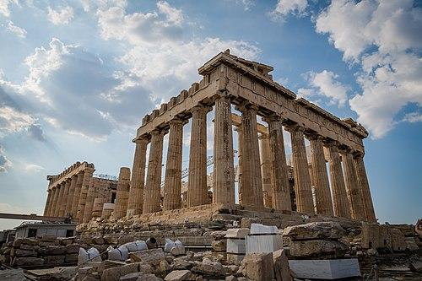
Ancient Greece and Rome
The Ancient Greeks and Romans are known to have played many ball games, some of which involved the use of the feet. The Roman game harpastum is believed to have been adapted from a Greek team game known as "ἐπίσκυρος" (Episkyros) or "φαινίνδα" (phaininda), which is mentioned by a Greek playwright, Antiphanes (388–311 BC) and later referred to by the Christian theologian Clement of Alexandria (c. 150 – c. 215 AD). These games appear to have resembled rugby football.
Ancient Greece

Slide 7

Native Americans
There are a number of references to traditional, ancient, or prehistoric ball games, played by indigenous peoples in many different parts of the world. For example, in 1586, men from a ship commanded by an English explorer named John Davis, went ashore to play a form of football with Inuit in Greenland. There are later accounts of an Inuit game played on ice, called Aqsaqtuk. Each match began with two teams facing each other in parallel lines, before attempting to kick the ball through each other team's line and then at a goal.
Indigenous peoples

Slide 8
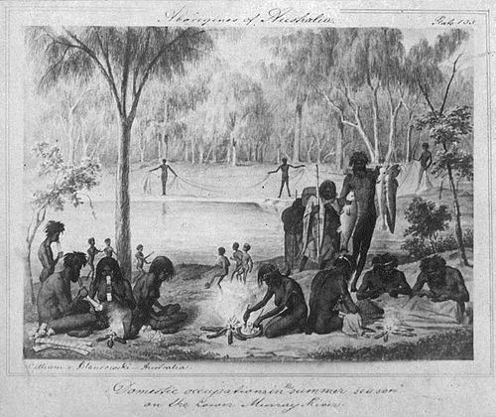
Oceania
On the Australian continent several tribes of indigenous people played kicking and catching games with stuffed balls which have been generalised by historians as Marn Grook (Djab Wurrung for "game ball").
Marn Grook

Slide 9
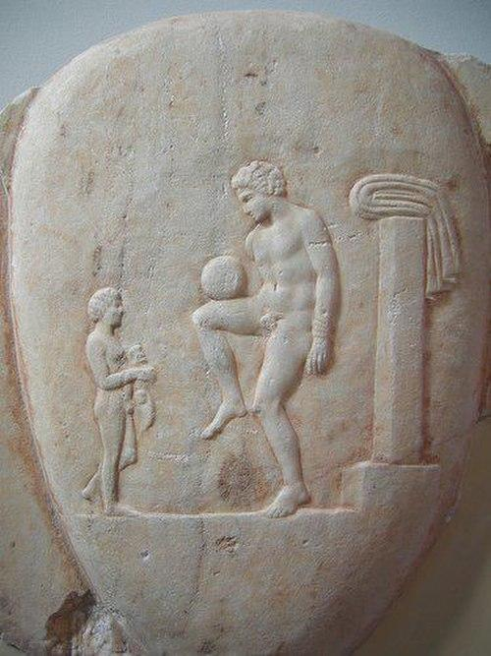
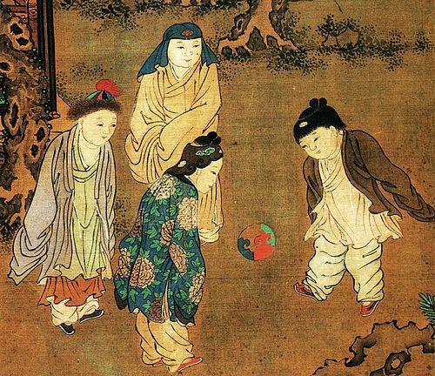
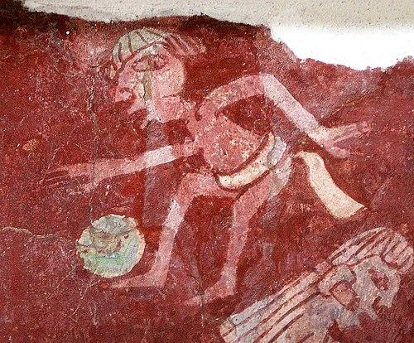
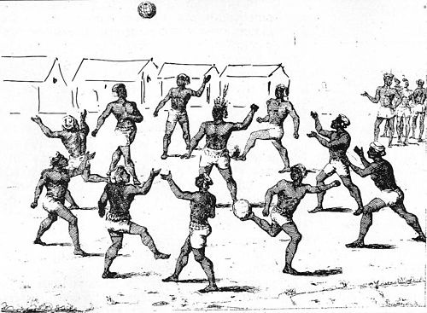
Turkic peoples
A group of indigenous people playing a ball game in French Guiana
A Song dynasty painting by Su Hanchen (c. 1130-1160), depicting Chinese children playing cuju
Paint of a Mesoamerican ballgame player of the Tepantitla murals in Teotihuacan
Ancient Greek athlete balancing a ball on his thigh, Piraeus, 400-375 BC

Slide 10
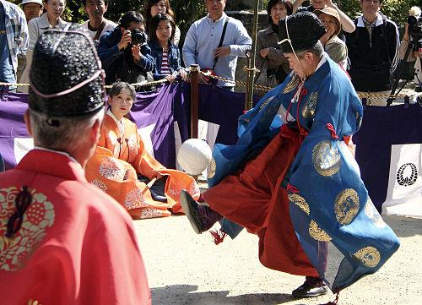
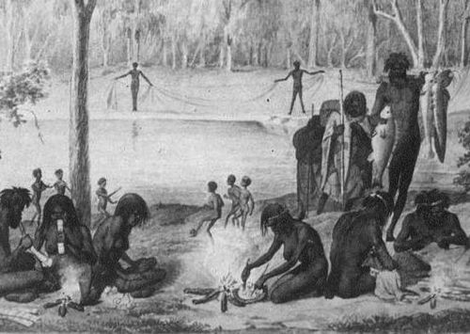
Ancient Greek athlete balancing a ball on his thigh, Piraeus, 400-375 BC
A Song dynasty painting by Su Hanchen (c. 1130-1160), depicting Chinese children playing cuju

Slide 11
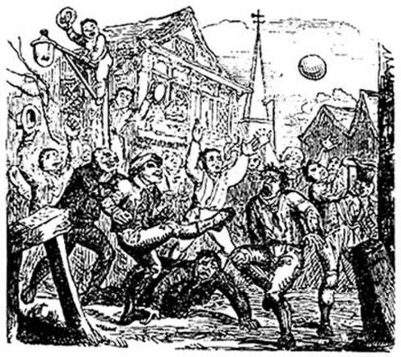
Medieval and early modern Europe
The Middle Ages saw a huge rise in popularity of annual Shrovetide football matches throughout Europe, particularly in England. An early reference to a ball game played in Britain comes from the 9th-century Historia Brittonum, attributed to Nennius, which describes "a party of boys . playing at ball". References to a ball game played in northern France known as La Soule or Choule, in which the ball was propelled by hands, feet, and sticks, date from the 12th century.
An illustration of so-called "mob football"

Slide 12
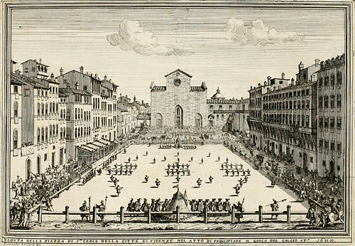
Calcio Fiorentino
In the 16th century, the city of Florence celebrated the period between Epiphany and Lent by playing a game which today is known as "calcio storico" ("historic kickball") in the Piazza Santa Croce. The young aristocrats of the city would dress up in fine silk costumes and embroil themselves in a violent form of football. For example, calcio players could punch, shoulder charge, and kick opponents. Blows below the belt were allowed. The game is said to have originated as a military training exercise.
An illustration of the Calcio Fiorentino field and starting positions, from a 1688 book by Pietro di Lorenzo Bini

Slide 13
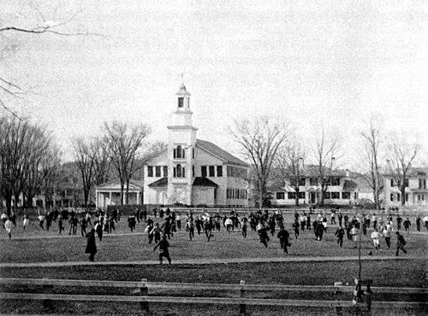
Official disapproval and attempts to ban football
There have been many attempts to ban football, from the middle ages through to the modern day. The first such law was passed in England in 1314; it was followed by more than 30 in England alone between 1314 and 1667. Women were banned from playing at English and Scottish Football League grounds in 1921, a ban that was only lifted in the 1970s. Female footballers still face similar problems in some parts of the world. American football also faced pressures to ban the sport.
Old division football

Slide 14
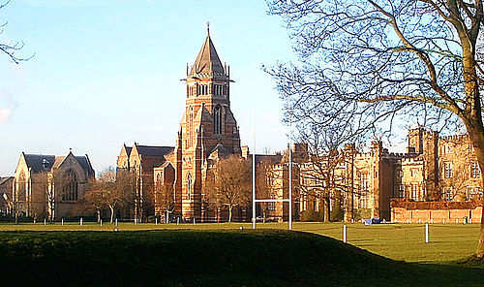
English public schools
While football continued to be played in various forms throughout Britain, its public schools (equivalent to private schools in other countries) are widely credited with four key achievements in the creation of modern football codes. First of all, the evidence suggests that they were important in taking football away from its "mob" form and turning it into an organised team sport. Second, many early descriptions of football and references to it were recorded by people who had studied at these schools.
Although the Rugby School (pictured) became famous due to a version that rugby football was invented there in 1823, most sports historians refuse this version stating it is apocryphal

Slide 15
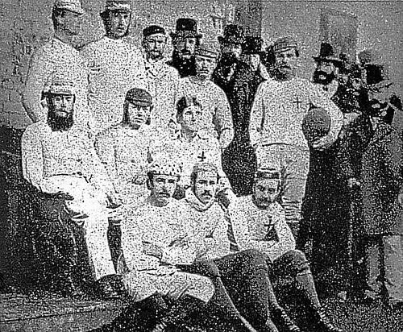
Clubs
Sports clubs dedicated to playing football began in the 18th century, for example London's Gymnastic Society which was founded in the mid-18th century and ceased playing matches in 1796. The first documented club to bear in the title a reference to being a 'football club' were called "The Foot-Ball Club" who were located in Edinburgh, Scotland, during the period 1824–41. The club forbade tripping but allowed pushing and holding and the picking up of the ball.
Sheffield F.C. (here pictured in 1857, the year of its foundation) is the oldest surviving association football club in the world

Slide 16

Competitions
One of the longest running football fixture is the Cordner-Eggleston Cup, contested between Melbourne Grammar School and Scotch College, Melbourne every year since 1858. It is believed by many to also be the first match of Australian rules football, although it was played under experimental rules in its first year. The first football trophy tournament was the Caledonian Challenge Cup, donated by the Royal Caledonian Society of Melbourne, played in 1861 under the Melbourne Rules.
Melbourne Grammar School

Slide 17
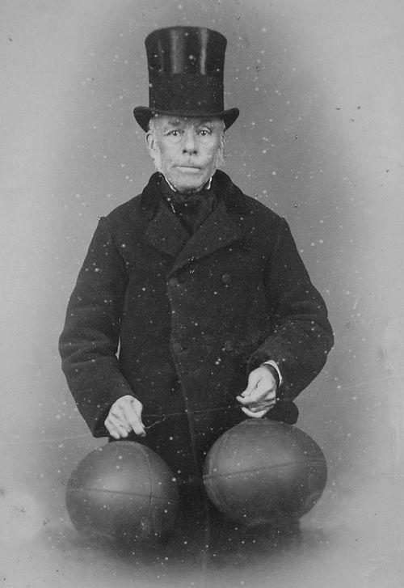
Modern balls
In Europe, early footballs were made out of animal bladders, more specifically pig's bladders, which were inflated. Later leather coverings were introduced to allow the balls to keep their shape. However, in 1851, Richard Lindon and William Gilbert, both shoemakers from the town of Rugby (near the school), exhibited both round and oval-shaped balls at the Great Exhibition in London. Richard Lindon's wife is said to have died of lung disease caused by blowing up pig's bladders.
Richard Lindon (seen in 1880) is believed to have invented the first footballs with rubber bladders

Slide 18
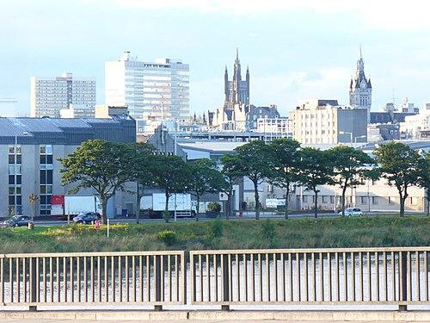
Modern ball passing tactics
The earliest reference to a game of football involving players passing the ball and attempting to score past a goalkeeper was written in 1633 by David Wedderburn, a poet and teacher in Aberdeen, Scotland.
Aberdeen

Slide 19
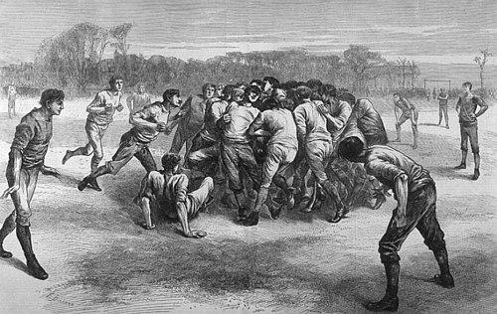
Rugby football
Rugby football was thought to have been started about 1845 at Rugby School in Rugby, Warwickshire, England although forms of football in which the ball was carried and tossed date to medieval times. In Britain, by 1870, there were 49 clubs playing variations of the Rugby school game. There were also "rugby" clubs in Ireland, Australia, Canada and New Zealand. However, there was no generally accepted set of rules for rugby until 1871, when 21 clubs from London came together to form the Rugby Football Union (RFU).
The Last Scrimmage by Edwin Buckman, depicting a rugby scrum in 1871

Slide 20

Cambridge rules
During the nineteenth century, several codifications of the rules of football were made at the University of Cambridge, in order to enable students from different public schools to play each other. The Cambridge Rules of 1863 influenced the decision of Football Association to ban Rugby-style carrying of the ball in its own first set of laws.
Emmanuel College Chapel

Slide 21

Sheffield rules
By the late 1850s, many football clubs had been formed throughout the English-speaking world, to play various codes of football. Sheffield Football Club, founded in 1857 in the English city of Sheffield by Nathaniel Creswick and William Prest, was later recognised as the world's oldest club playing association football. However, the club initially played its own code of football: the Sheffield rules. The code was largely independent of the public school rules, the most significant difference being the lack of an offside rule.
Sheffield

Slide 22
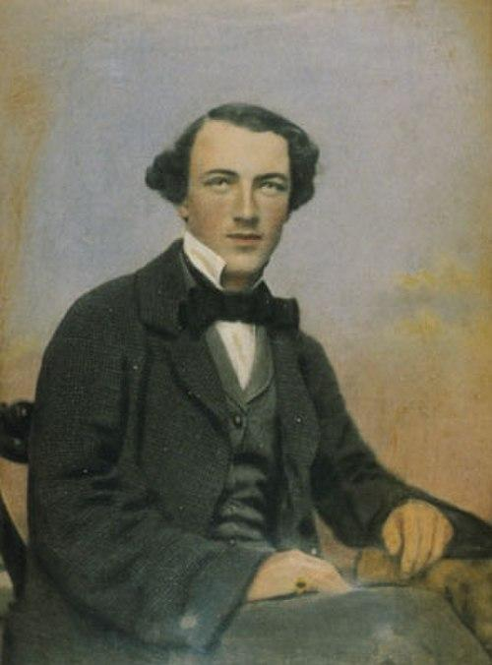
Australian rules football
There is archival evidence of "foot-ball" games being played in various parts of Australia throughout the first half of the 19th century. The origins of an organised game of football known today as Australian rules football can be traced back to 1858 in Melbourne, the capital city of Victoria. In July 1858, Tom Wills, an Australian-born cricketer educated at Rugby School in England, wrote a letter to Bell's Life in Victoria & Sporting Chronicle, calling for a "foot-ball club" with a "code of laws" to keep cricketers fit during winter.
Tom Wills, major figure in the creation of Australian football

Slide 23
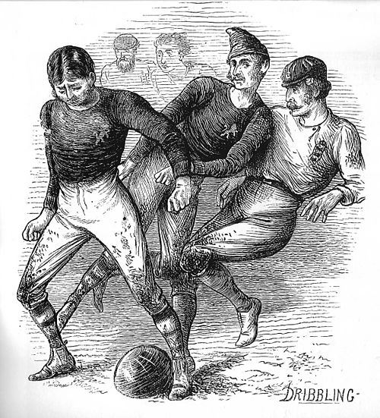
Football Association
During the early 1860s, there were increasing attempts in England to unify and reconcile the various public school games. In 1862, J. C. Thring, who had been one of the driving forces behind the original Cambridge Rules, was a master at Uppingham School and he issued his own rules of what he called "The Simplest Game" (these are also known as the Uppingham Rules).

Slide 24
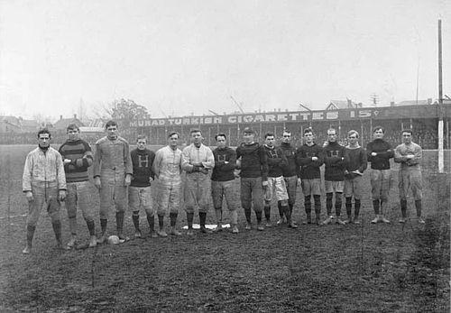
North American football codes
As was the case in Britain, by the early 19th century, North American schools and universities played their own local games, between sides made up of students. For example, students at Dartmouth College in New Hampshire played a game called Old division football, a variant of the association football codes, as early as the 1820s. They remained largely "mob football" style games, with huge numbers of players attempting to advance the ball into a goal area, often by any means necessary. Rules were simple, violence and injury were common.
The Tigers of Hamilton, Ontario, circa 1906. Founded 1869 as the Hamilton Foot Ball Club, they eventually merged with the Hamilton Flying Wildcats to form the Hamilton Tiger-Cats, a team still active in the Canadian Football League.

Slide 25
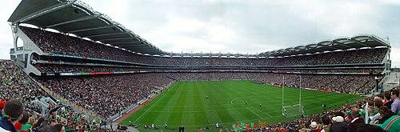
Gaelic football
In the mid-19th century, various traditional football games, referred to collectively as caid, remained popular in Ireland, especially in County Kerry. One observer, Father W. Ferris, described two main forms of caid during this period: the "field game" in which the object was to put the ball through arch-like goals, formed from the boughs of two trees; and the epic "cross-country game" which took up most of the daylight hours of a Sunday on which it was played, and was won by one team taking the ball across a parish boundary.
The All-Ireland Football Final in Croke Park, 2004

Slide 26
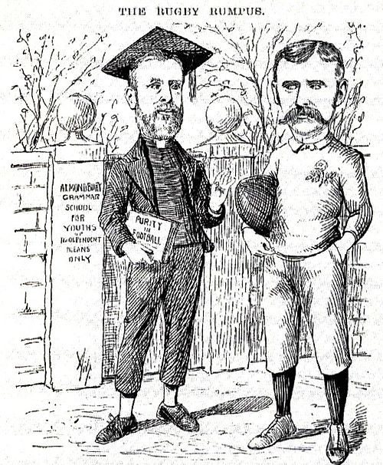
Schism in Rugby football
The International Rugby Football Board (IRFB) was founded in 1886, but rifts were beginning to emerge in the code. Professionalism had already begun to creep into the various codes of football. In England, by the 1890s, a long-standing Rugby Football Union ban on professional players was causing regional tensions within rugby football, as many players in northern England were working class and could not afford to take time off to train, travel, play and recover from injuries.
An English cartoon from the 1890s lampooning the divide in rugby football which led to the formation of rugby league. The caricatures are of Rev. Frank Marshall, an arch-opponent of player payments, and James Miller, a long-time opponent of Marshall. The caption reads: Marshall: "Oh, fie, go away naughty boy, I don't play with boys who can’t afford to take a holiday for football any day they like!" Miller: "Yes, that's just you to a T; you’d make it so that no lad whose father wasn’t a millionaire could play at all in a really good team. For my part I see no reason why the men who make the money shouldn’t have a share in the spending of it."

Slide 27
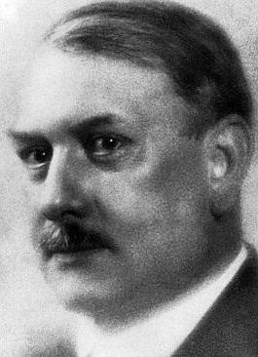
Globalisation of association football
The need for a single body to oversee association football had become apparent by the beginning of the 20th century, with the increasing popularity of international fixtures. The English Football Association had chaired many discussions on setting up an international body, but was perceived as making no progress. It fell to associations from seven other European countries: France, Belgium, Denmark, Netherlands, Spain, Sweden, and Switzerland, to form an international association.
Robert Guérin

Slide 28
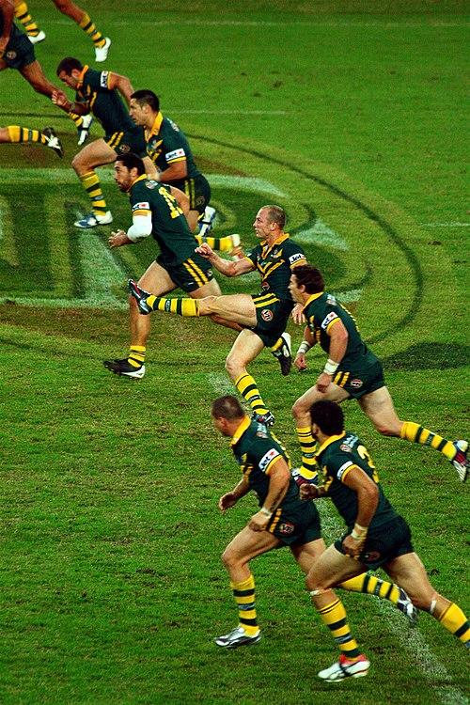
Further divergence of the two rugby codes
Rugby league rules diverged significantly from rugby union in 1906, with the reduction of the team from 15 to 13 players. In 1907, a New Zealand professional rugby team toured Australia and Britain, receiving an enthusiastic response, and professional rugby leagues were launched in Australia the following year. However, the rules of professional games varied from one country to another, and negotiations between various national bodies were required to fix the exact rules for each international match.
Rugby league in Australia

Slide 29
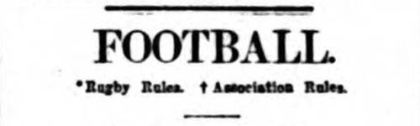
Use of the word "football"
The word football, when used in reference to a specific game can mean any one of those described above. Because of this, much controversy has occurred over the term football, primarily because it is used in different ways in different parts of the English-speaking world. Most often, the word "football" is used to refer to the code of football that is considered dominant within a particular region (which is association football in most countries). So, effectively, what the word "football" means usually depends on where one says it.
Heading from The Sportsman (London) front page of 25 November 1910, illustrating the continued use of the word "football" to encompass both association football and rugby

Slide 30
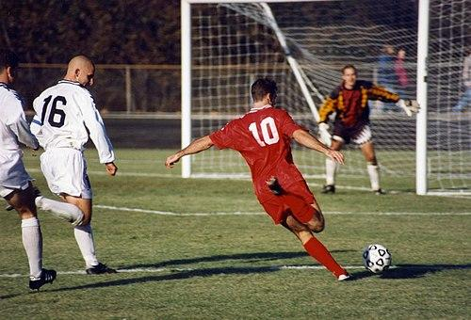
Popularity
Several of the football codes are the most popular team sports in the world. Globally, association football is played by over 250 million players in over 200 nations, and has the highest television audience in sport, making it the most popular in the world. American football, with 1. 1 million high school football players and nearly 70,000 college football players, is the most popular sport in the United States, with the annual Super Bowl game accounting for nine of the top ten of the most watched broadcasts in U. S. television history.
Association football

Slide 31
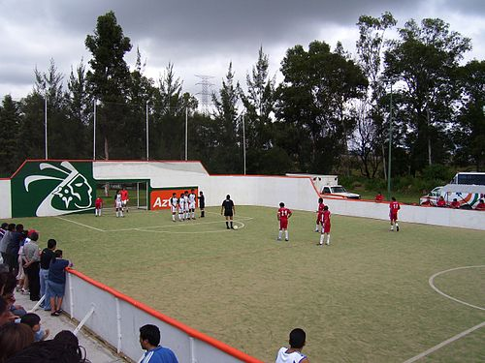
Association
These codes have in common the prohibition of the use of hands (by all players except the goalkeeper, though outfield players can "throw-in" the ball when it goes out of play), unlike other codes where carrying or handling the ball by all players is allowedAssociation football, also known as football, soccer, footy and footie, Indoor/basketball court variants:Five-a-side football – game for smaller teams, played under various rules including:Futebol de Salão, Futsal – the FIFA-approved five-a-side indoor game, Minivoetbal – the five-a-side
An indoor soccer game at an open-air venue in Mexico. The referee has just awarded the red team a free kick.

Slide 32
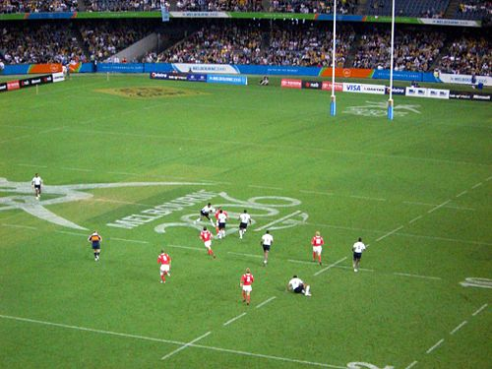
Rugby
These codes have in common the ability of players to carry the ball with their hands, and to throw it to teammates, unlike association football where the use of hands during play is prohibited by anyone except the goalkeeper. They also feature various methods of scoring based upon whether the ball is carried into the goal area, or kicked above the goalposts. Rugby footballRugby unionMini rugby a variety for children. Rugby sevens and Rugby tens – variants for teams of reduced size.
Rugby sevens; Fiji v Wales at the 2006 Commonwealth Games in Melbourne

Slide 33
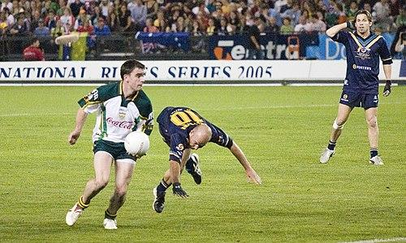
Irish and Australian
These codes have in common the absence of an offside rule, the prohibition of continuous carrying of the ball (requiring a periodic bounce or solo (toe-kick), depending on the code) while running, handpassing by punching or tapping the ball rather than throwing it, and other traditions. Australian rules football – officially known as "Australian football", and informally as "football", "footy" or "Aussie rules".
International rules football test match from the 2005 International Rules Series between Australia and Ireland at Telstra Dome, Melbourne, Australia.

Slide 34
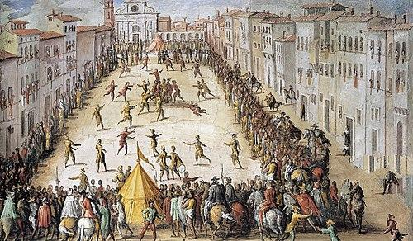
Medieval
Calcio Fiorentino – a modern revival of Renaissance football from 16th century Florence. la Soule – a modern revival of French medieval football, lelo burti – a Georgian traditional football game
Calcio Fiorentino

Slide 35

Britain
The Haxey Hood, played on Epiphany in Haxey, Lincolnshire, Shrove Tuesday gamesScoring the Hales in Alnwick, Northumberland, Royal Shrovetide Football in Ashbourne, Derbyshire, The Shrovetide Ball Game in Atherstone, Warwickshire, The Shrove Tuesday Football Ceremony of the Purbeck Marblers in Corfe Castle, Dorset, Hurling the Silver Ball at St Columb Major in Cornwall, The Ball Game in Sedgefield, County Durham, , In Scotland the Ba game ("Ball Game") is still popular around Christmas and Hogmanay at:Duns, Berwickshire, Scone, Perthshire
Haxey Hood

Slide 36
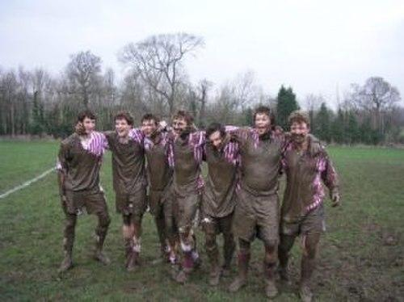
British schools
Games still played at UK public (independent) schools:Eton field game, Eton wall game, Harrow football, Winchester College football
Harrow football players after a game at Harrow School (circa 2005).

Slide 37

Recent and hybrid
Keepie uppie (keep up) – the art of juggling with a football using the feet, knees, chest, shoulders, and head.Footbag – several variations using a small bean bag or sand bag as a ball, the trade marked term hacky sack is sometimes used as a generic synonym. Freestyle football – participants are graded for their entertainment value and expression of skill.
Keepie uppie

Slide 38
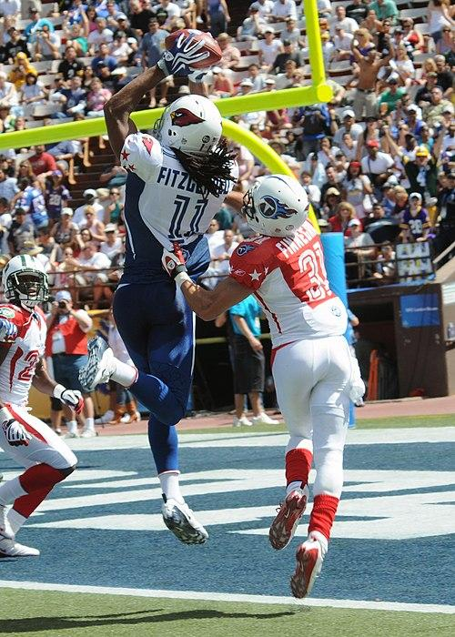
Hybrid
Austus – a compromise between Australian rules and American football, invented in Melbourne during World War II. Bossaball – mixes Association football and volleyball and gymnastics; played on inflatables and trampolines. Cycle ball – a sport similar to association football played on bicycles, Footgolf – golf played by kicking an Association football. Footvolley – mixes Association football and beach volleyball;
American football

Slide 39
Tabletop games, video games, and other recreations

Slide 40
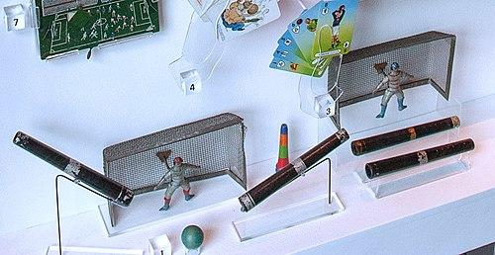
Based on association football
Blow football, Button football – also known as Futebol de Mesa, Jogo de Botões, Fantasy football, FIFA Video Games Series, Lego Football, Mario Strikers, Penny football, Pro Evolution Soccer, Subbuteo, Table football – also known as foosball, table soccer, babyfoot, bar football or gettone
Blow football

Slide 41
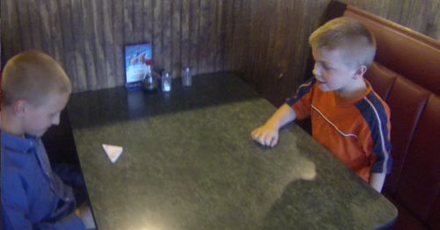
Based on American football
Blood Bowl, Fantasy football (American), Madden NFL, Paper football
Paper football

Slide 42
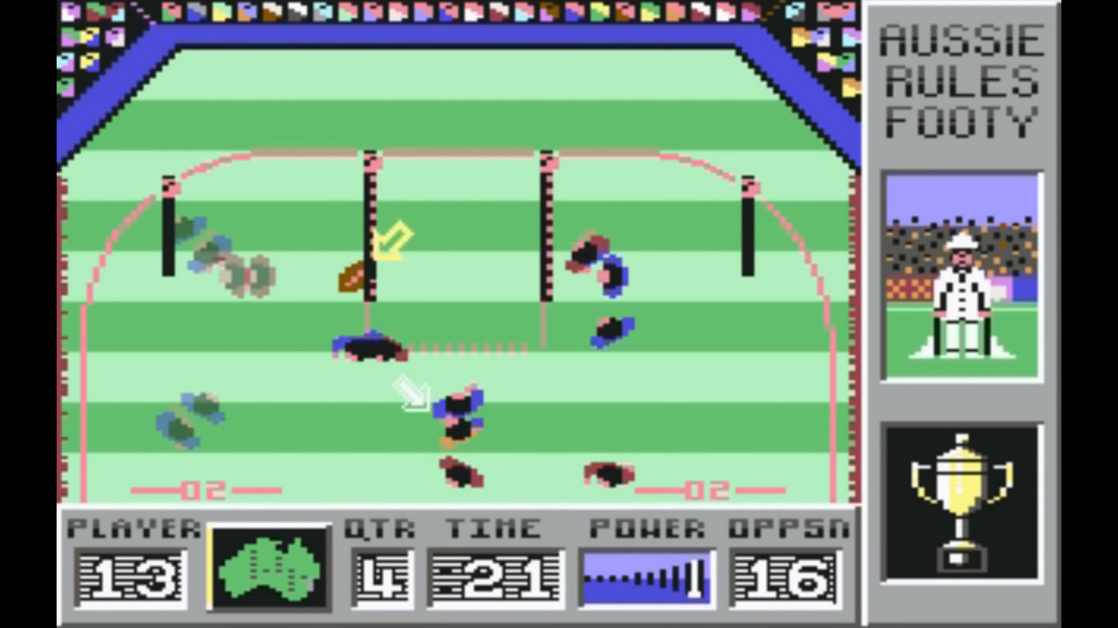
Based on Australian football
AFL video game seriesList of AFL video games,
AFL video games

Slide 43
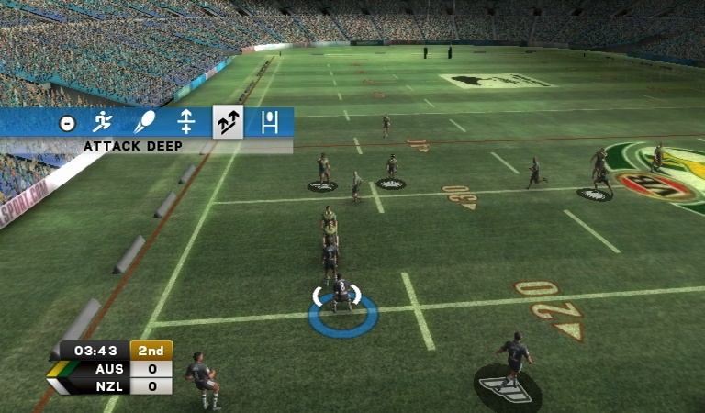
Based on rugby league football
Australian Rugby League, Sidhe's Rugby League series Rugby League 3
Rugby League 3

Slide 44



