Slide 1
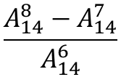
$$\frac{A_{14}^{8}−A_{14}^{7}}{A_{14}^{6}}$$

