Slide 1

NEW YEAR

Slide 2
We have been celebrated New Year for 46 year before our era. It’s beautiful holiday which celebrate every year with our family.

Slide 3
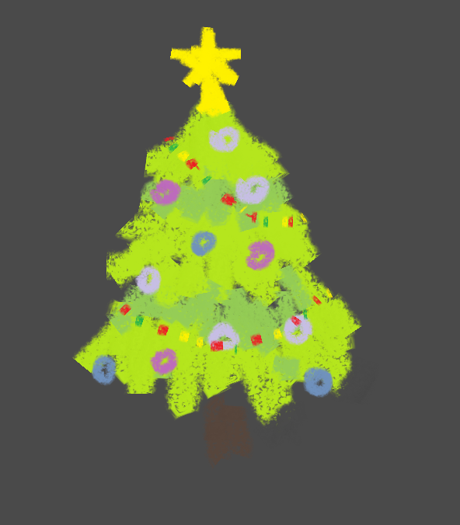
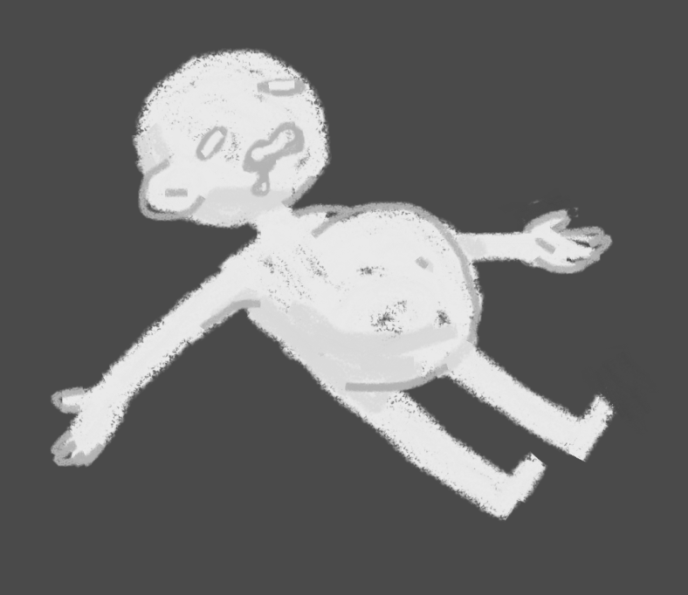

Traditional thing there are :
CHISTMAS TREE
A LOT OF FOOD
GIFTS
GRANTPA FROST(FATHER)

Slide 4
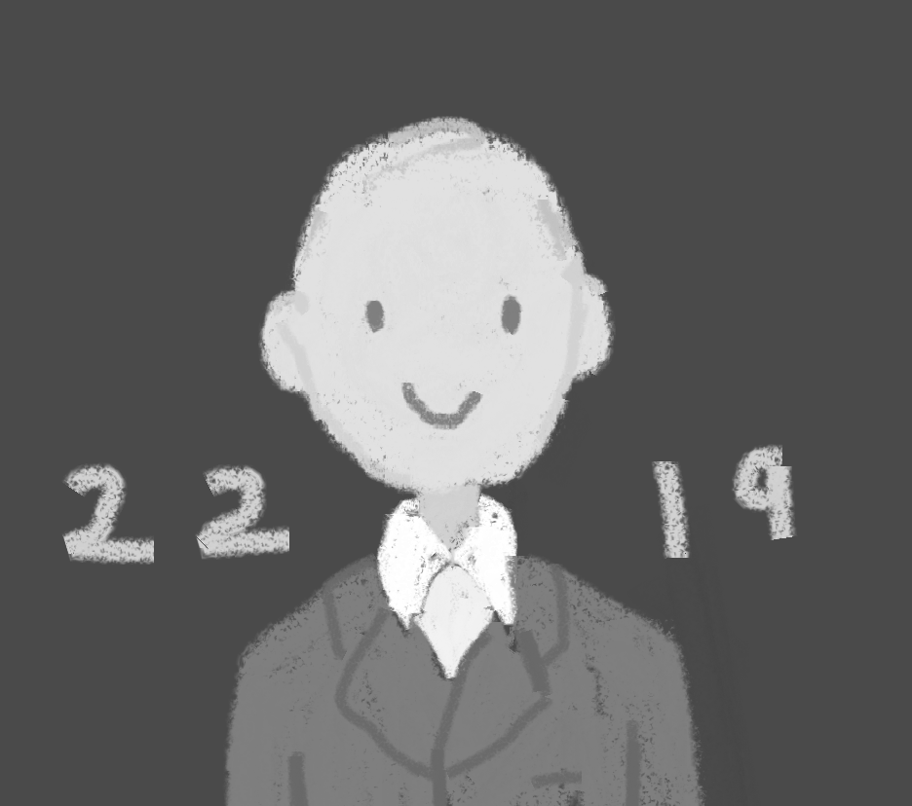
AND PRESIDENT

Slide 5
AND PRESIDENT

Slide 6
FROM FOOD
SALADS (FOR EXAMPLE WINTER SALAD, CRAB SALAD, HERRING UNDER THE FUR COAT)
BAKED CHIKEN
DRINKS (FOR EXAMPLE JUICE , PEPSI ) SHANPANSKOE

Slide 7
FROM DECORATION:
CHRISTMAS BALL
GERLANG
MESHURA
STAR

Slide 8
I JUST LIKE THIS HOLIDAY BECOUSE I LIKE TO EAT

Slide 9

WATCH AND LISTEN HAMILTON

