Slide 1
Sport in My Life
Solovyeva Olsen
7 «Z» class of school No. 1324 Moscow

Slide 2
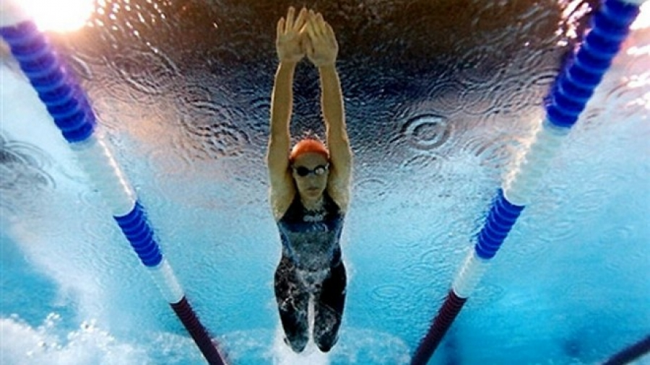
Sport takes an important place in my life.

Slide 3
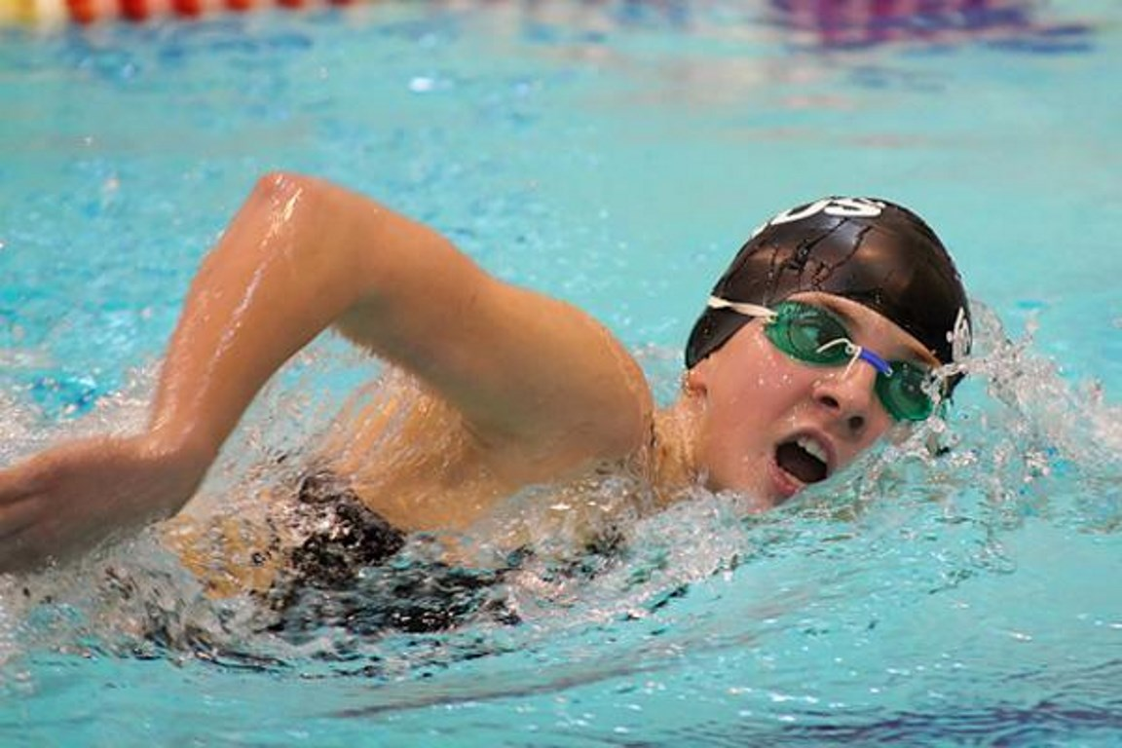
I’ve been going to swimming school for six years.

Slide 4
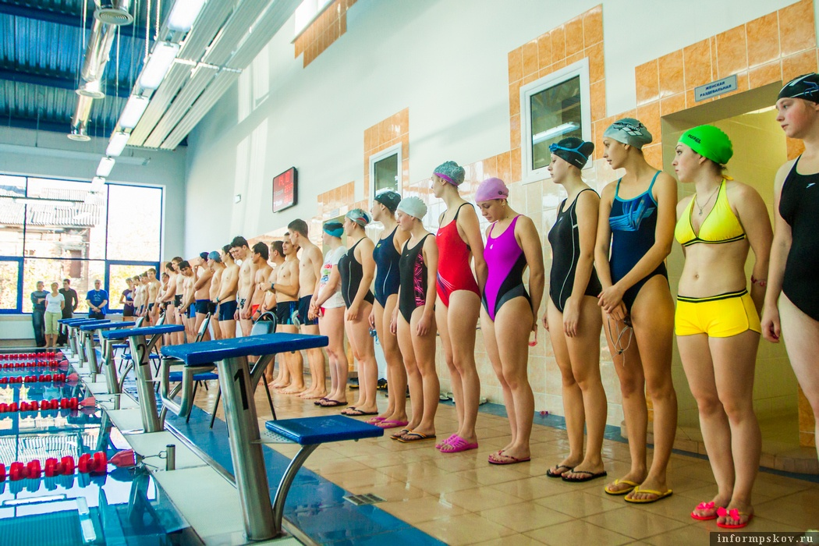
I go to trainings three days a week.

Slide 5
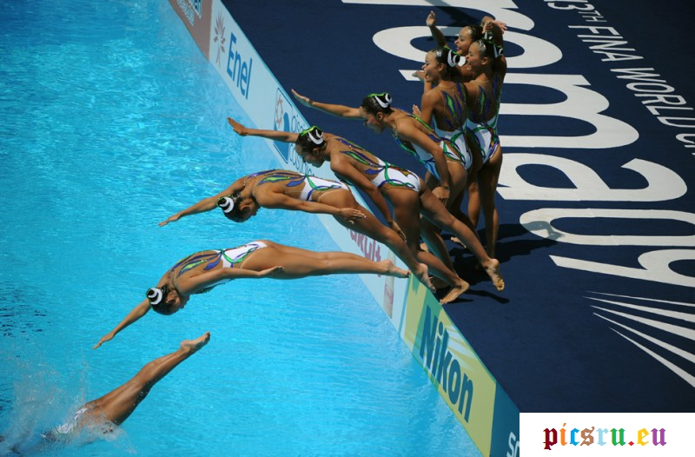
Now I often take part in different swimming competitions.

Slide 6
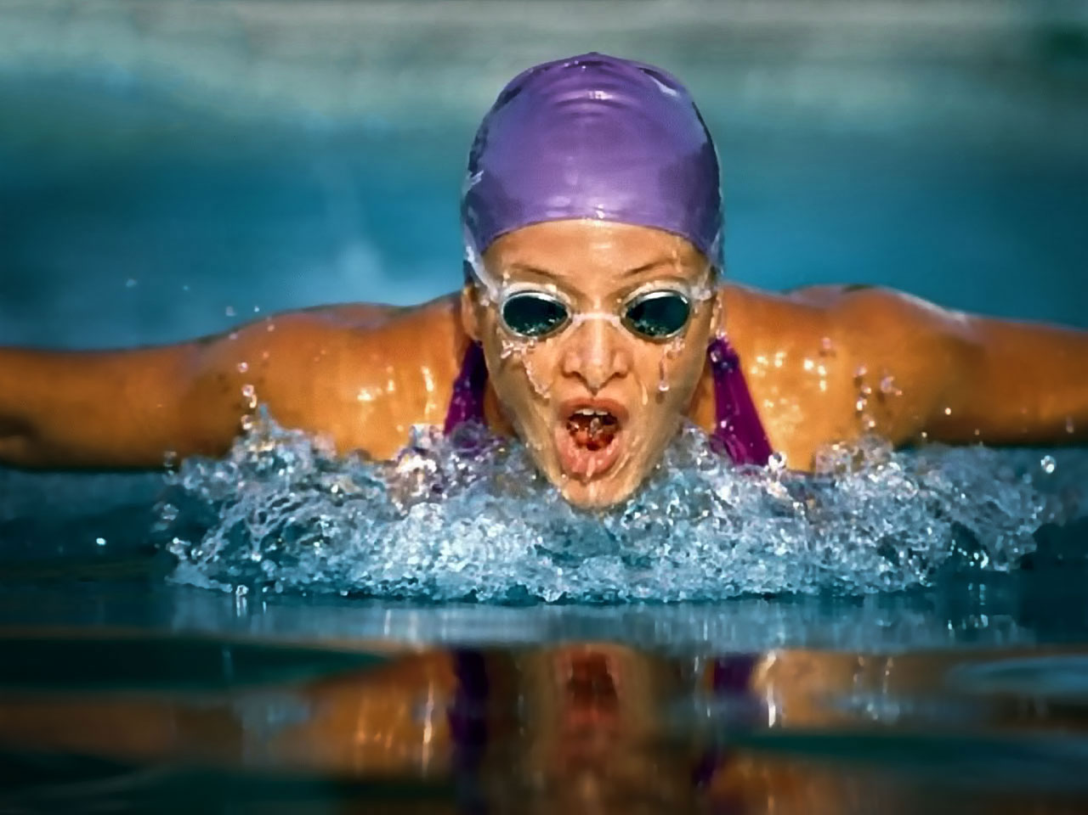
Most of all I like to use the breaststroke.

Slide 7
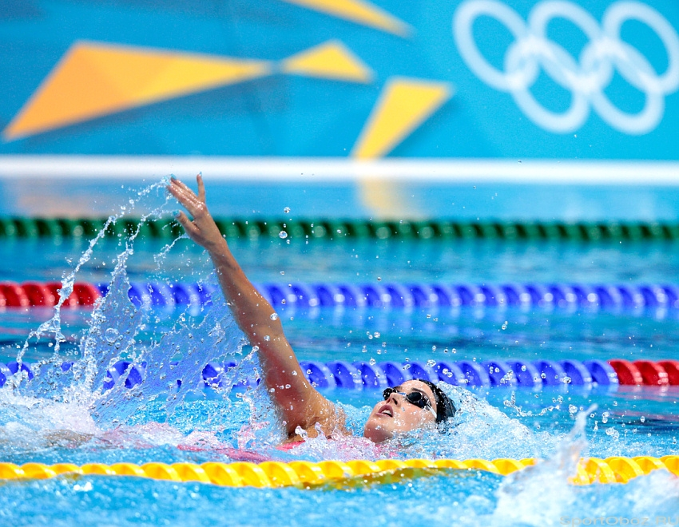
Sport gives me health, strength and self-reliance.

Slide 8
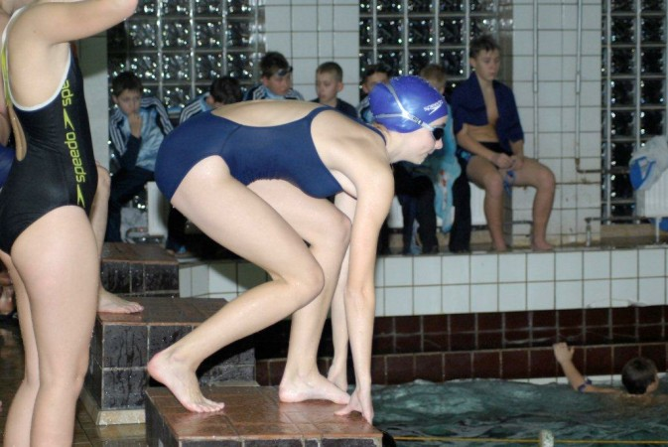
Now I have sport figure. I consider that sport is my reliable helper.

