Slide 1
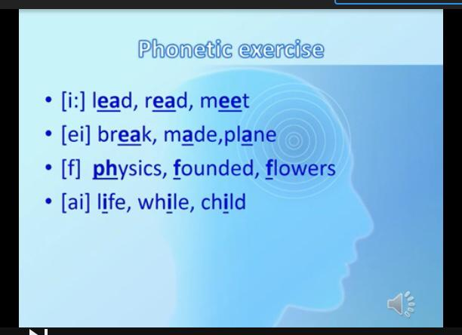
10 ^{th} form Unit 1 Science and scientific phenomena .
The theme: “ Famous Scientists”
Learning objectives. 10.2.1- understand the main points in unsupported extended talk on a wide range of general and curricular topics, including talk
on a limited range of unfamiliar topics;
Phonetic exercise.
9

Slide 2
Task 1.New words
1. to discover
2. founder
3.scientists
4.matter
5.science
6.to establish
7. inventor
8.achivement
9.innovator

Slide 3
Task 2
1 ex 1 a) p 7 Complete the descriptions (1-5) with . Invented, founded, developed, argued, discovered .
1. Developed the theory of relativity.
2._____ the World Wide Web
3._____ radioactivity and won the Nobel Prize twice
4._____ that the Sun was at the centre of the universe.
5. ____ the environmental organization Eco Center.

Slide 4
Task 3. Answer the questions.
1. What world- famous scientist do you know?
2. What is your favorite scientist?
3. Is important to create new ideas and inventions?
4.What do you think about such people?

Slide 5
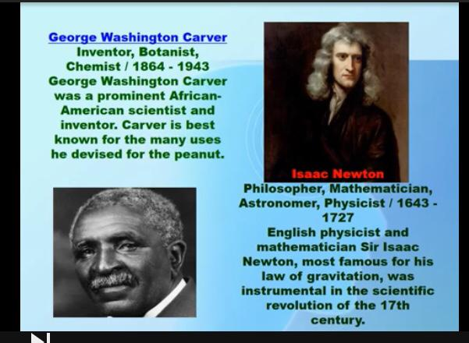
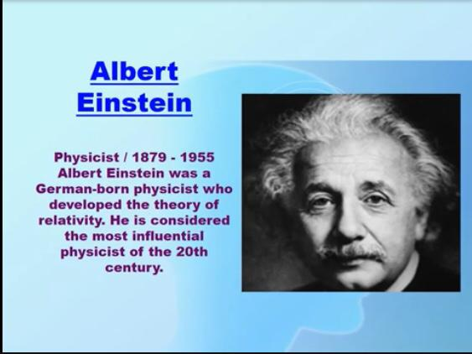
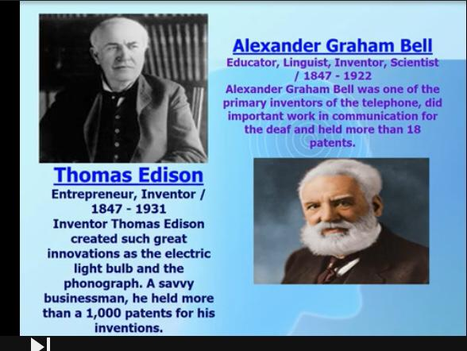
Task 4 Reading
There are a large number of famous scientists in history . If a roster of all such scientists were to be compiled, the list would be never- ending. Hence a finite number has been taken into consideration here. These great individuals were masters in their respective fields , and with their amazing work, changed the course of history and the way things were done . We`ll have a look at the top scientists the world has ever seen.

Slide 6
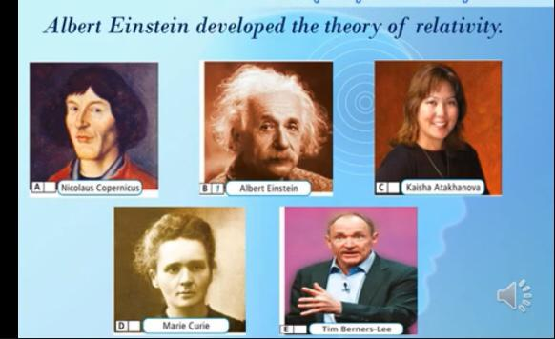
Task 5 .Ex. 2. p 7 Which famous scientist is related to. Physics, astronomy, biology, computer, science, chemistry?

Slide 7

Task 6. Home task: WB ex 6 ,8 p. 6
Ескерту: Тапсырманы дәптеріңе орында, аяқтаған соң, суретке түсіріп маған тексеруге жібер. Күтем! Сенің қолыңнан бәрі келеді! Сәттілік!

