Slide 1
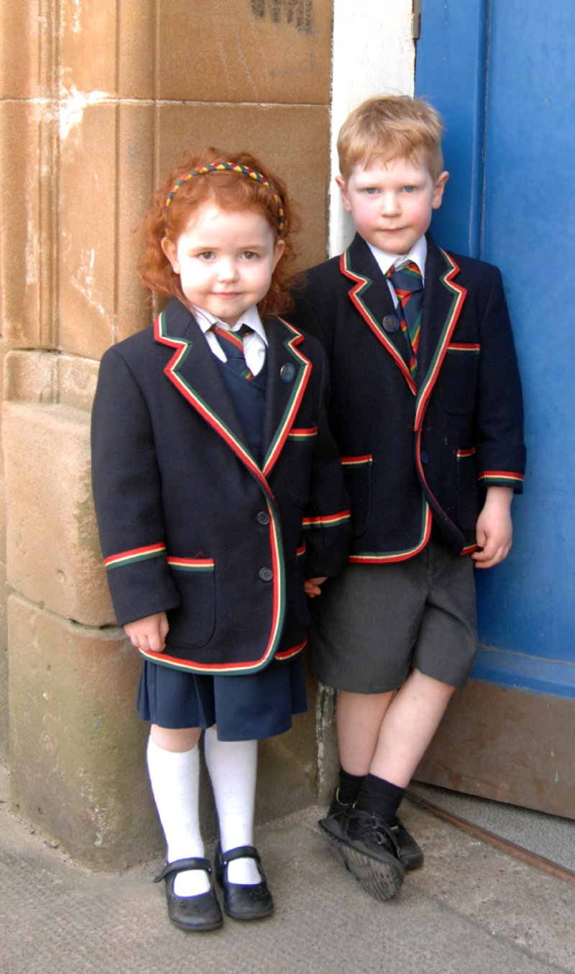
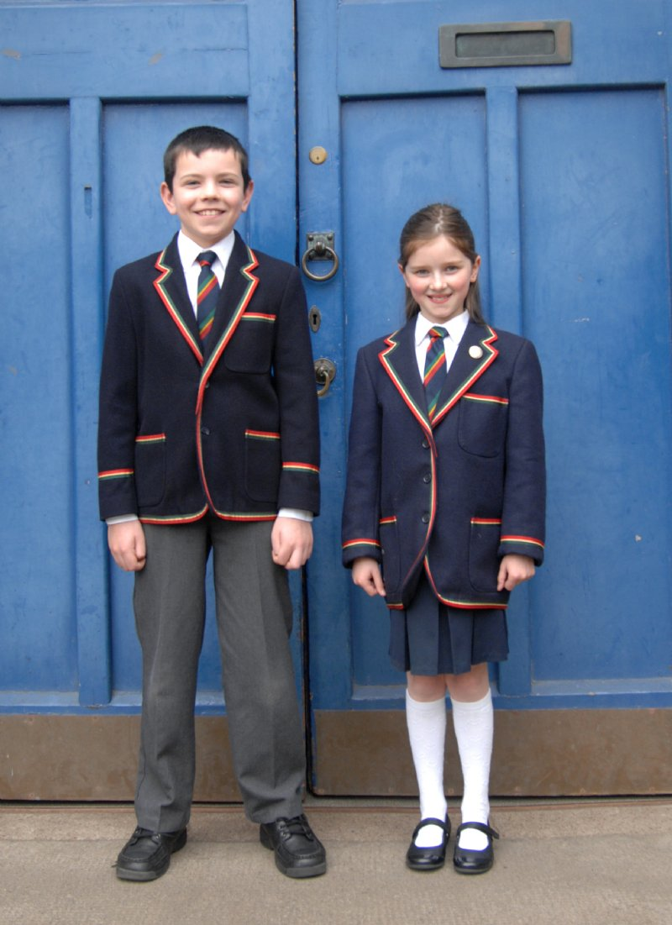
Cool school uniform

Slide 2
What is a uniform?
“A school uniform is an outfit—a set of standardized clothes—worn primarily for an educational institution. They are common in primary and secondary schools in many nations. When used, they form the basis of a school's dress code.

Slide 3
A school uniform in Russia
A school uniform came to Russia from England in 1834. The first uniforms were made for boys and some years later for girls. Boys had special shirts, trousers, black boots and a cap. Girls wore brown dresses and aprons.

Slide 4

Our school - leavers
There is also a modern-day tradition for girls to dress into brown Soviet-style school uniform for their graduation ceremony.

Slide 5
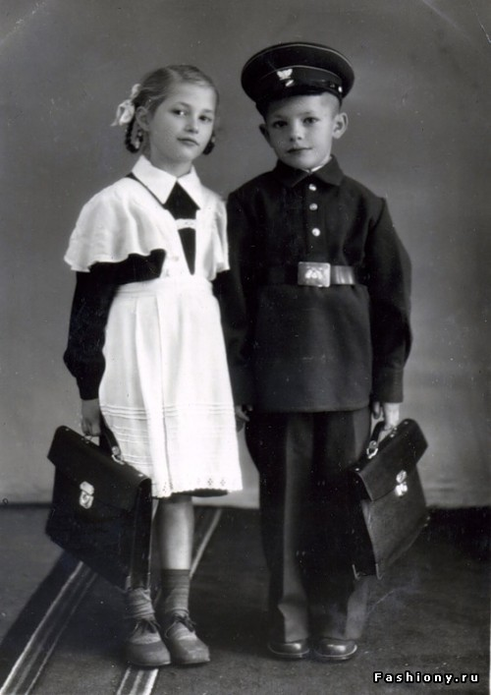
From the history of a school uniform.
School uniforms were first introduced during the reign of King Henry VIII in England. The first school to introduce this uniform was Christ's Hospital.

Slide 6
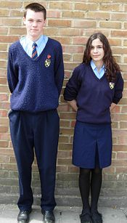
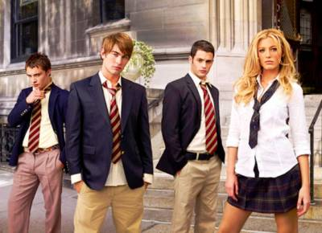
In Great Britain
Most British primary and secondary schools require pupils to wear uniforms. Boys wear a white shirt, long grey or black trousers ,jumper or sweater with the school logo on, school tie, black shoes. The color is the choice of the schools. Girls wear trousers or skirts as part of their uniform - typically black, grey, navy, or sometimes brown or maroon. During the summer term girls often wear summer school dresses

Slide 7
In the USA
Few state schools in the United States have formal school uniforms, but most have dress codes.

Slide 8
Are you for or against a school uniform?
«For»
There are no differences between children from families with different income.
It is easier for students to choose what to wear to school.
School uniforms help maintain school discipline.
A school uniform helps build school spiritrm?
«Аgainst»
School uniforms suppress individuality, development of personality, creativity.
Uniforms are not cheap.
There is no credible evidence that school uniforms improve school discipline or promote higher academic achievement.

Slide 9
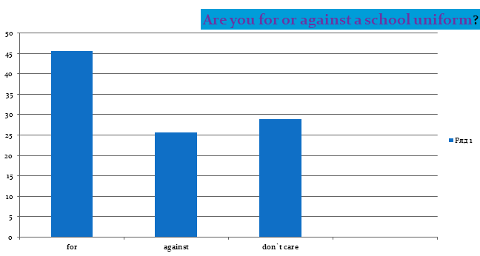
What do our pupils think?

Slide 10
Proverbs
Cut your coat according to your cloth. - По одежке протягивай ножки.
Cut your coat to suit your cloth.- По материи и пальто крои. По Сеньке и шапка.
Good clothes open all doors.- Хорошая одежда открывает все двери. По одежде встречают.

Slide 11

Thank you for your attention

