Slide 1
Youth subcultures of 21
century.

Slide 2
Youth subculture is models of behavior, style of clothes, musical preferences, language (slang), specific values and their symbolic expressions typical for groups of young people.
Youth subcultures existed long ago, at least, since the second half of the 20th century. The most famous examples - hippies, punks, rockers, metals.

Slide 3
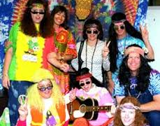
Hippies
Today there are two groups: Old hippies and young hippies.
They wear their hair long, they usually wear untidy clothes, they prefer to be free and not to work.

Slide 4
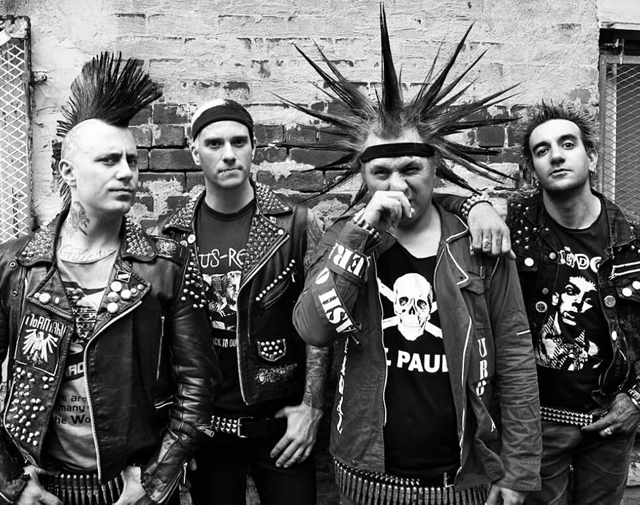
Punk
Punks appeared in the UK, more precisely in Wales, in the first half of 30 years. So called themselves people who lived and poor areas of cities, as a rule, children of coal miners. Music of punks in 30 years was "black jazz", performed by the Nets. The ideology is based on anarchy and complete denial of the state and society. Gradually, the punks of those years turned into people who listen to punk and punk rock.
They love extravagant dresses and hairstyles
They wear lots of rings, bracelets and bells.
They pierce their noses and ears with pins.
They have brightly dyed hair.

Slide 5
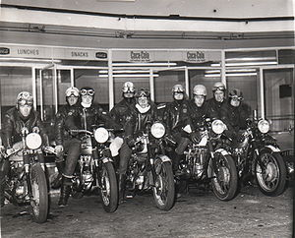
Rockers
This subculture originated in 1950 in the UK, which featured motorcycles in the style of coffee-raiser and rock-n-roll.
Rockers bought standard factory-made motorcycles and stripped them down, tuning them up and modifying them to appear like racing bikes. Their bikes were not merely transport, but were used as an object of intimidation and masculinity projecting them uneasily close to death, an element exaggerated by their use of skull and crossbone-type symbolism.
Rockers wore heavily decorated leather motorcycle jackets.

Slide 6
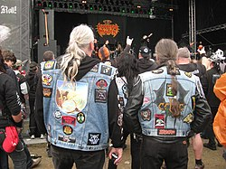
Metalhead
This subculture inspired by music in metal style. Appeared in 80 years.
The most popular in northern Europe, Germany, France, Poland, America.
Metalist have no ideology and are concentrated only around music.

