Slide 1
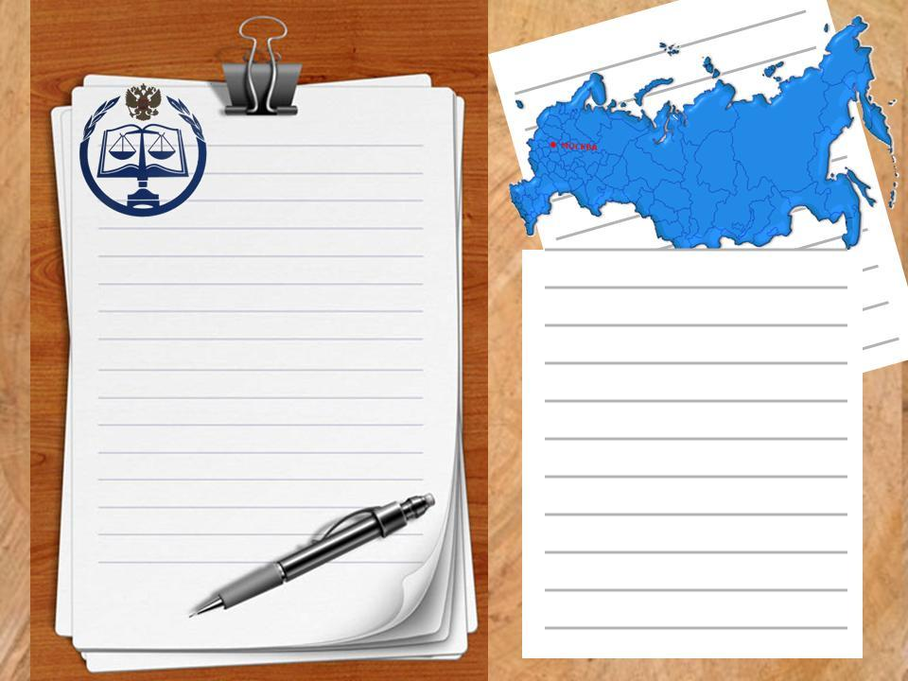
Welcome to Wales
Работа
Ученика
ООШ №
Ф.И

Slide 2
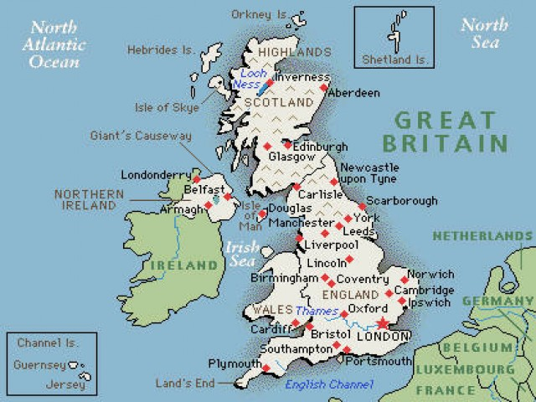
Wales is a part of the United Kingdom and is located in a wide peninsula in the western portion of the island of Great Britain. Wales is surrounded by water on three sides: to the north, the Irish Sea; to the south, the Bristol Channel; and to the west, Saint George's Channel and Cardigan Bay.

Slide 3
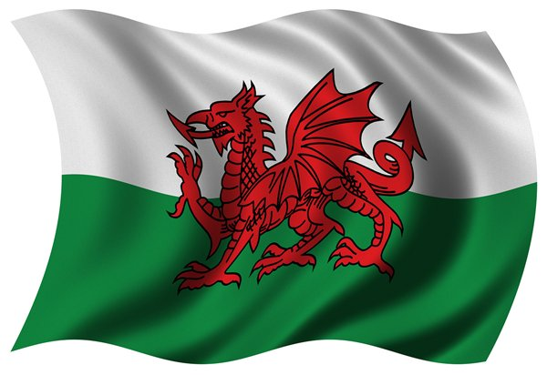
The national flag consists of two stripes - white and green and a red dragon.

Slide 4
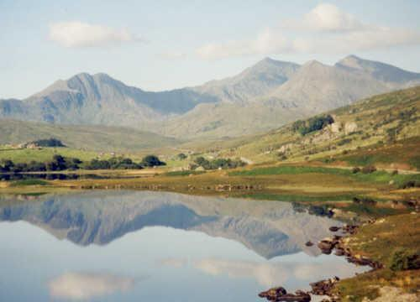
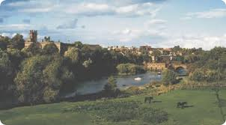
Wales is very mountainous, Snowdonis the highest mountain in Wales and England.
The Dee River, with its headwaters in Bala Lake, the largest natural lake in Wales, flows through northern Wales into England. Numerous smaller rivers cover the south, including the Usk, Wye, Teifi, and Towy.
The Welsh is a Celtic language. It has very musical intonation and many difficult sounds. It is very difficult to learn.

Slide 5
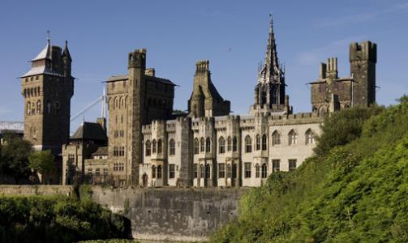

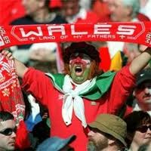
Cardiff
The Romans settled in Cardiff in 55AD and built a military fort on the site of Cardiff Castle.
Cardiff has been transformed into a sporting capital since the completion of the Millennium Stadium, hosting events such as the Six Nations, the FA Cup and the Wales Rally GB.
Cardiff became a city in 1905 and was crowned the capital of Wales in 1955
Today, Cardiff has a population of 328,000 and attracts more than 12 million visitors a year
Cardiff Castle
Millennium Stadium

Slide 6
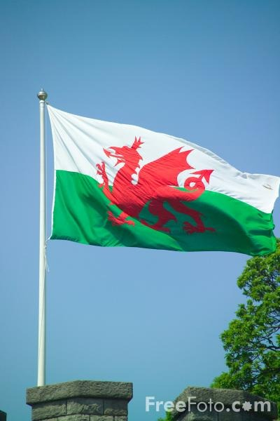
Most road signs in Wales are both in English and in Welsh because for many people Welsh is the first language. It is taught at schools side by side with English.

Slide 7
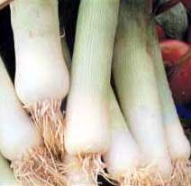
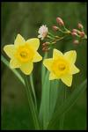

The leek had been recognized as the emblem of Wales since the middle of the 16th century.
Symbols of Wales
The national plants are the leek and the daffodil.
It was decided that from 1984, British £1 coins would feature different reverse designs for each of the four parts of the United Kingdom. All £1 coins dated 1985 feature on the reverse the Welsh Leek

Slide 8

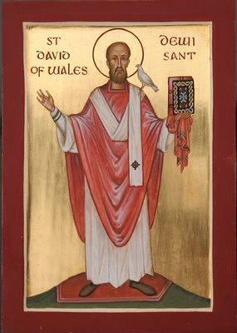
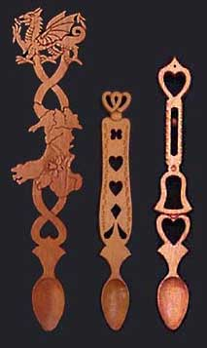
The symbols of Wales are the national flag the national plants and the national costume. The Red Dragon of Wales, although perhaps of Chinese origin, was introduced to Britain by the Romans some eighteen hundred years ago.
A favourite souvenir for the tourists is a Welsh love spoon. They are made of wood and are carved very beautifully. Originally, they were made by young men as a love token for their sweethearts. There are many different designs demonstrating the skill and love of the hopefulsuitor. If the girl kept this present, all was well, but if she sent it back, she did not want him.
St. David
St. David is the patron saint of Wales. He was a monk who lived on bread, water, herbs and leeks and died on March 1, 589 A. D.

Slide 9
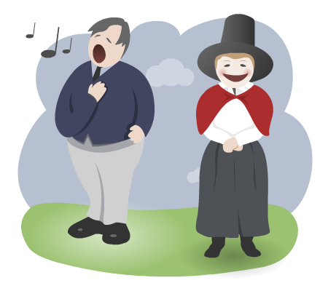
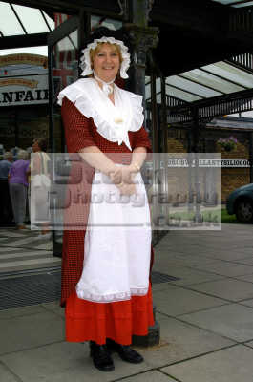
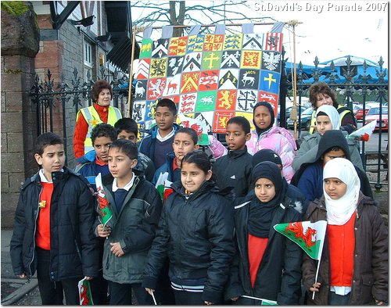
The national costume in worn by women and includes a long dress, a red jacket and a tall black hat.
English and Welsh are the two official languages of Wales. English is the most widely spoken language.
Just over 3 million people live in Wales. The majority of people that live in Wales ,live in Southern Wales, while the remaining population lives in Northern Wales.
Wales has always been known as a country of music and song.

Slide 10
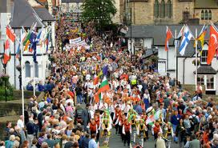
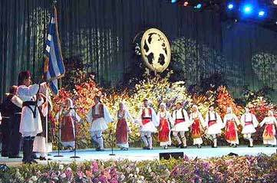
Since the 12th century we have records of an annual competition (or Eisteddfod [ais'teSvad] in Welsh), which was held to find the best poets, writers and musicians in the country. Originally only professionals took part, but now the
Eisteddfod is open to the public and, because all the events are in Welsh, it encourages a strong interest in the Welsh arts.

