Slide 1
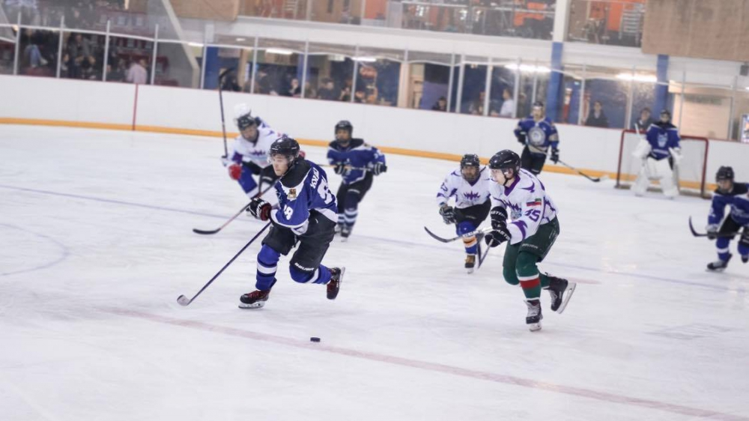
Ice hockey Паша Шамин
ICE HOCKEY BY PAVEL SHAMIN

Slide 2
introduction
In this Project I want to tell about the ice hockey.
History of hockey
Hockey today
End

Slide 3
History of hockey
There is no exact information about what is the prototype of the game, but there are three versions of how hockey appeared in Canada.
According to one of them, hockey was brought to the country by the French. France was the colonizer of Canada from the middle of the 16th century to the middle of the 18th century. The word "hockey" is derived from the French word hoquet, which means a curved shepherd's staff. With his help, French peasants competed in a game similar to hockey.

Slide 4
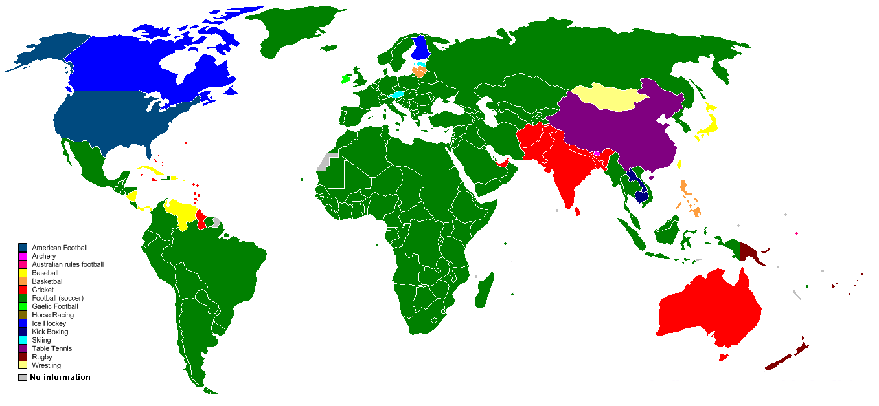
Hockey today
Today hockey is very cool game. I`m interested in hockey. Graphic popular sports:

Slide 5
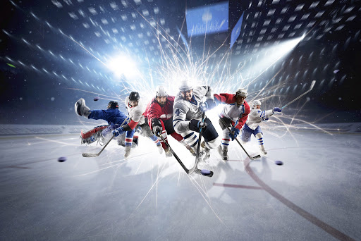

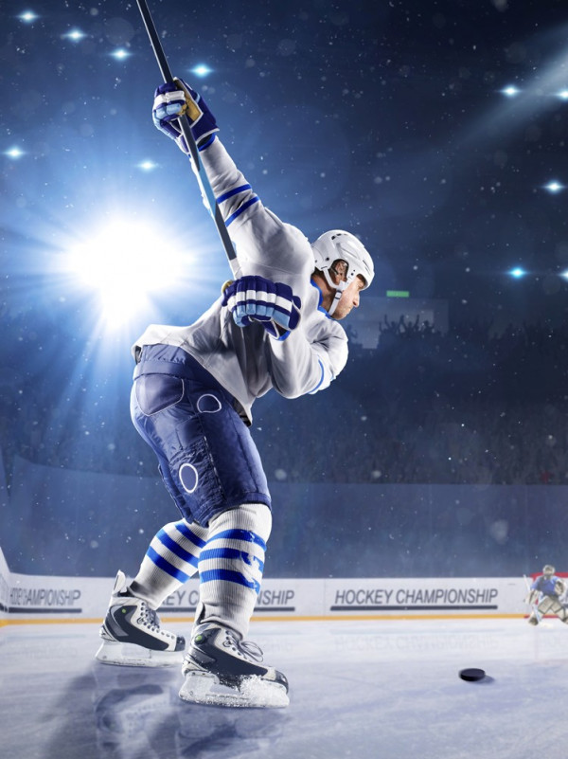
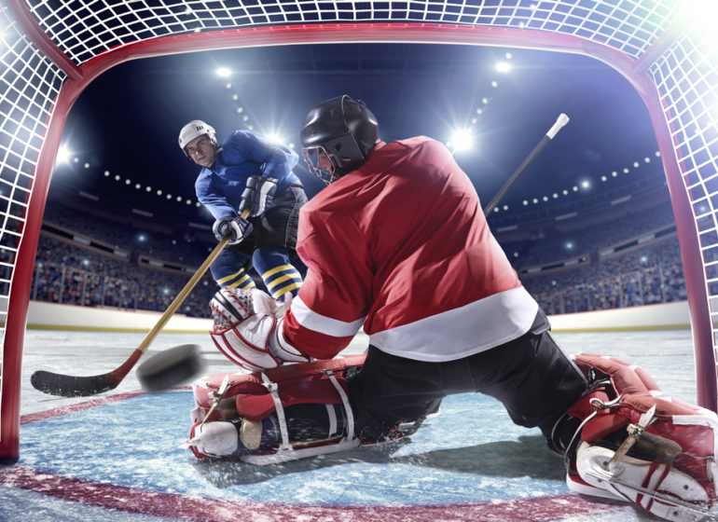
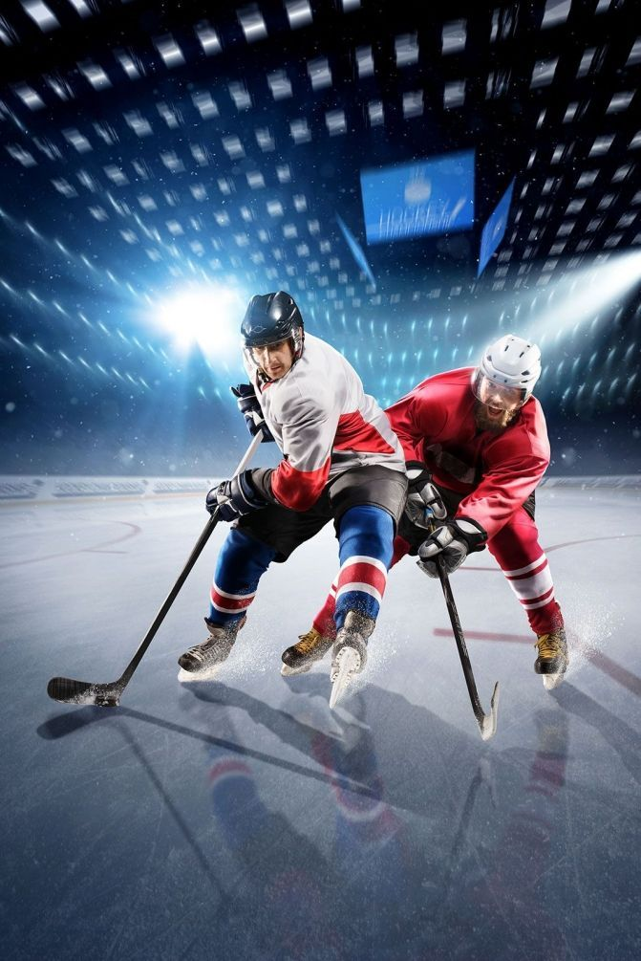
Photo of hockey

Slide 6

end

